Slide 1
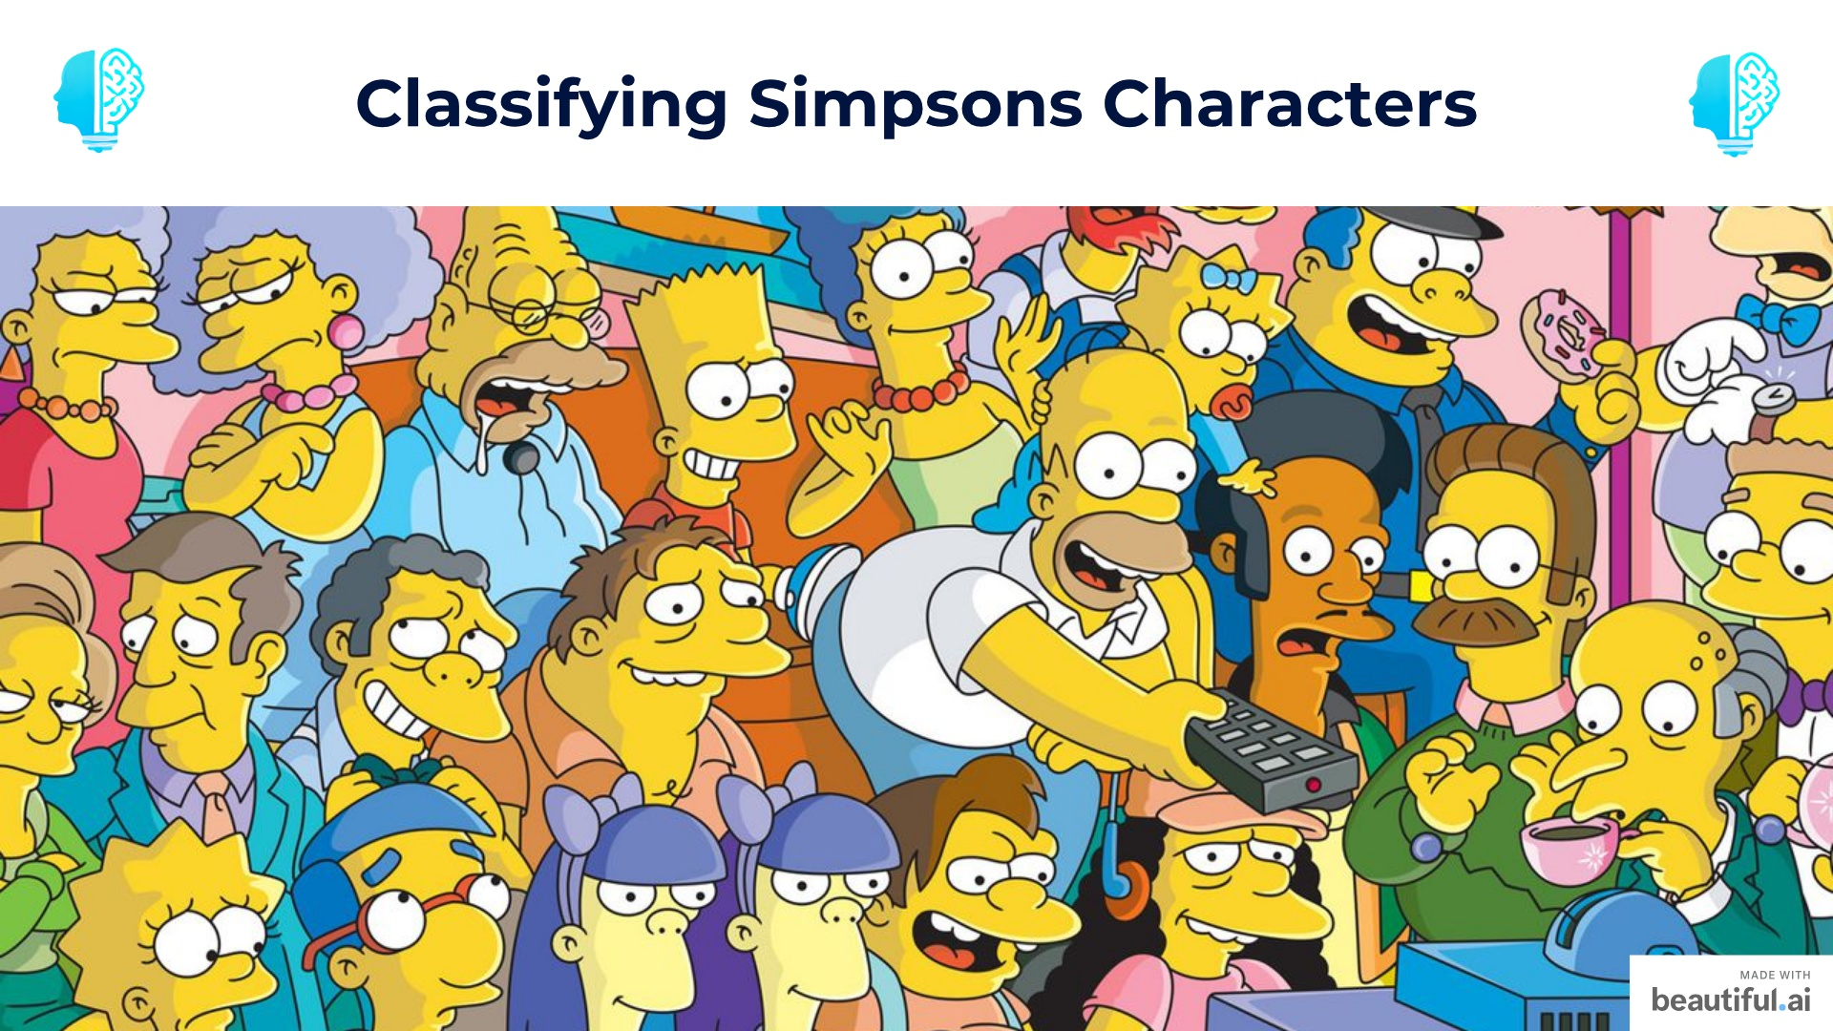
Notes:
— intro event and welcome and thank everyone — Ask how many people attended the previous workshop — mention code being shown but notebook will be shared so don't need to rush and copy code just make sure you understand everything. Slides will also be shared. before everyone comes in: — put intro music — prepare teams live stream — prepare powerpoint — open kahoot and run the session (check next slide for kahoot login details)

Slide 2


Slide 3
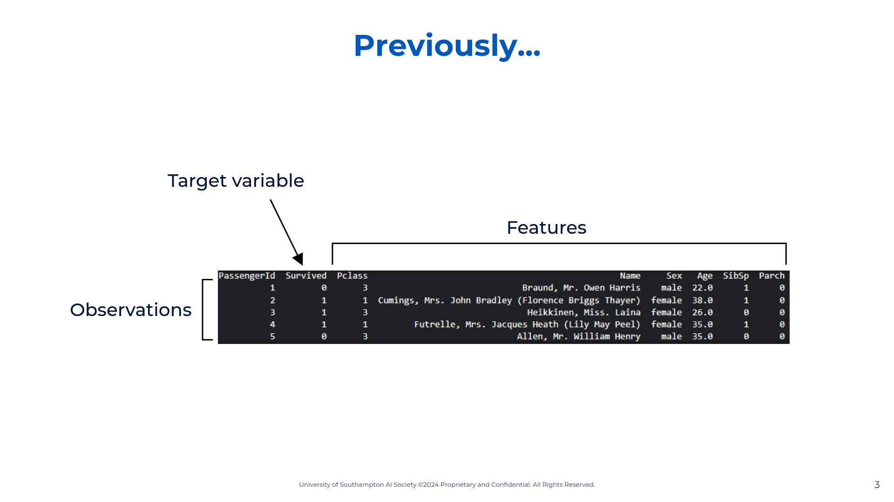
Notes:
So let's look at our dataset. This is the dataset's first rows taken from my command prompt when opening it. I'm showing it to you like this so you familiarize yourself. So we have our target variable which is survived. We can see it only stores 0 (died) and 1 (survived). So we know this is a classification model. We can also see our x-features, aka our x variables: Pclass, Name, Sex, Age, SibSp, Parch, Ticket, Fare, Cabin, Embarked. So now that we have defined our variables and the type of model we can start building our model. The model I chose for you was the logistic regression model as it is the starting point for classification models.

Slide 4
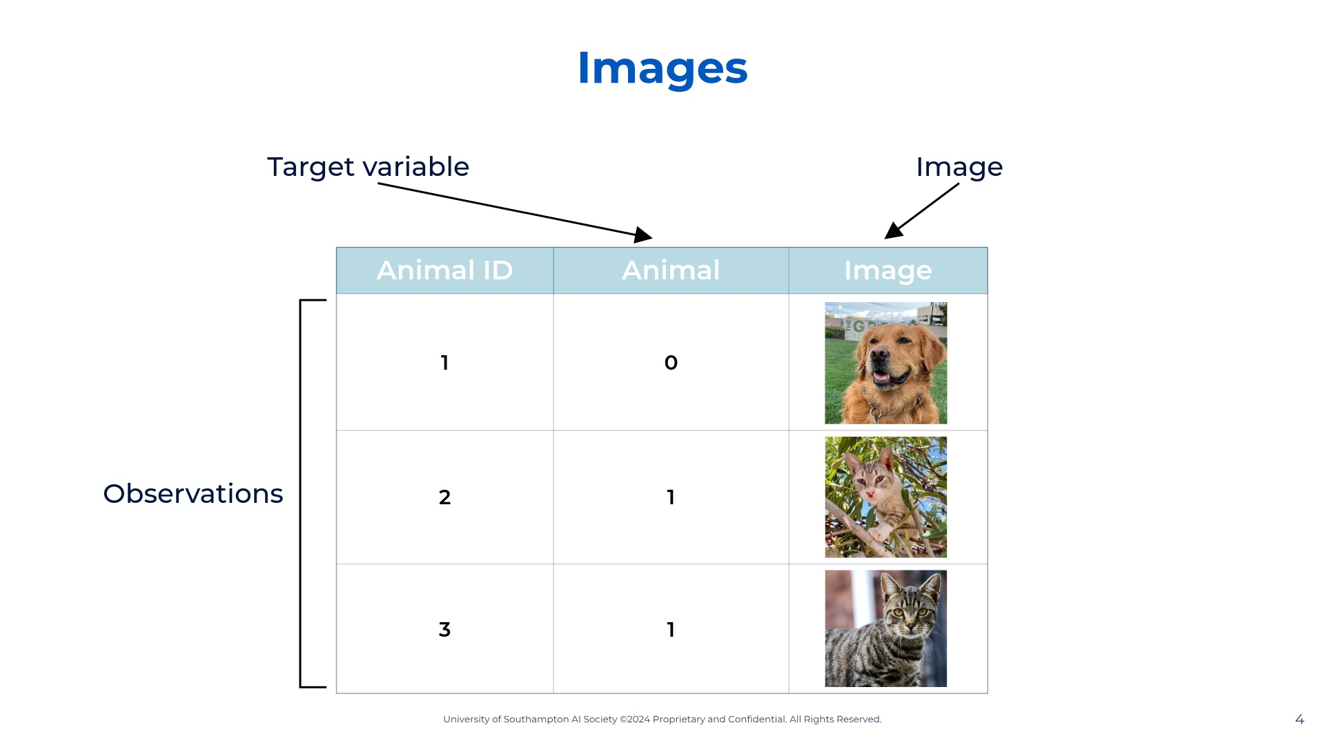
Notes:
So let's look at our dataset. This is the dataset's first rows taken from my command prompt when opening it. I'm showing it to you like this so you familiarize yourself. So we have our target variable which is survived. We can see it only stores 0 (died) and 1 (survived). So we know this is a classification model. We can also see our x-features, aka our x variables: Pclass, Name, Sex, Age, SibSp, Parch, Ticket, Fare, Cabin, Embarked. So now that we have defined our variables and the type of model we can start building our model. The model I chose for you was the logistic regression model as it is the starting point for classification models.

Slide 5
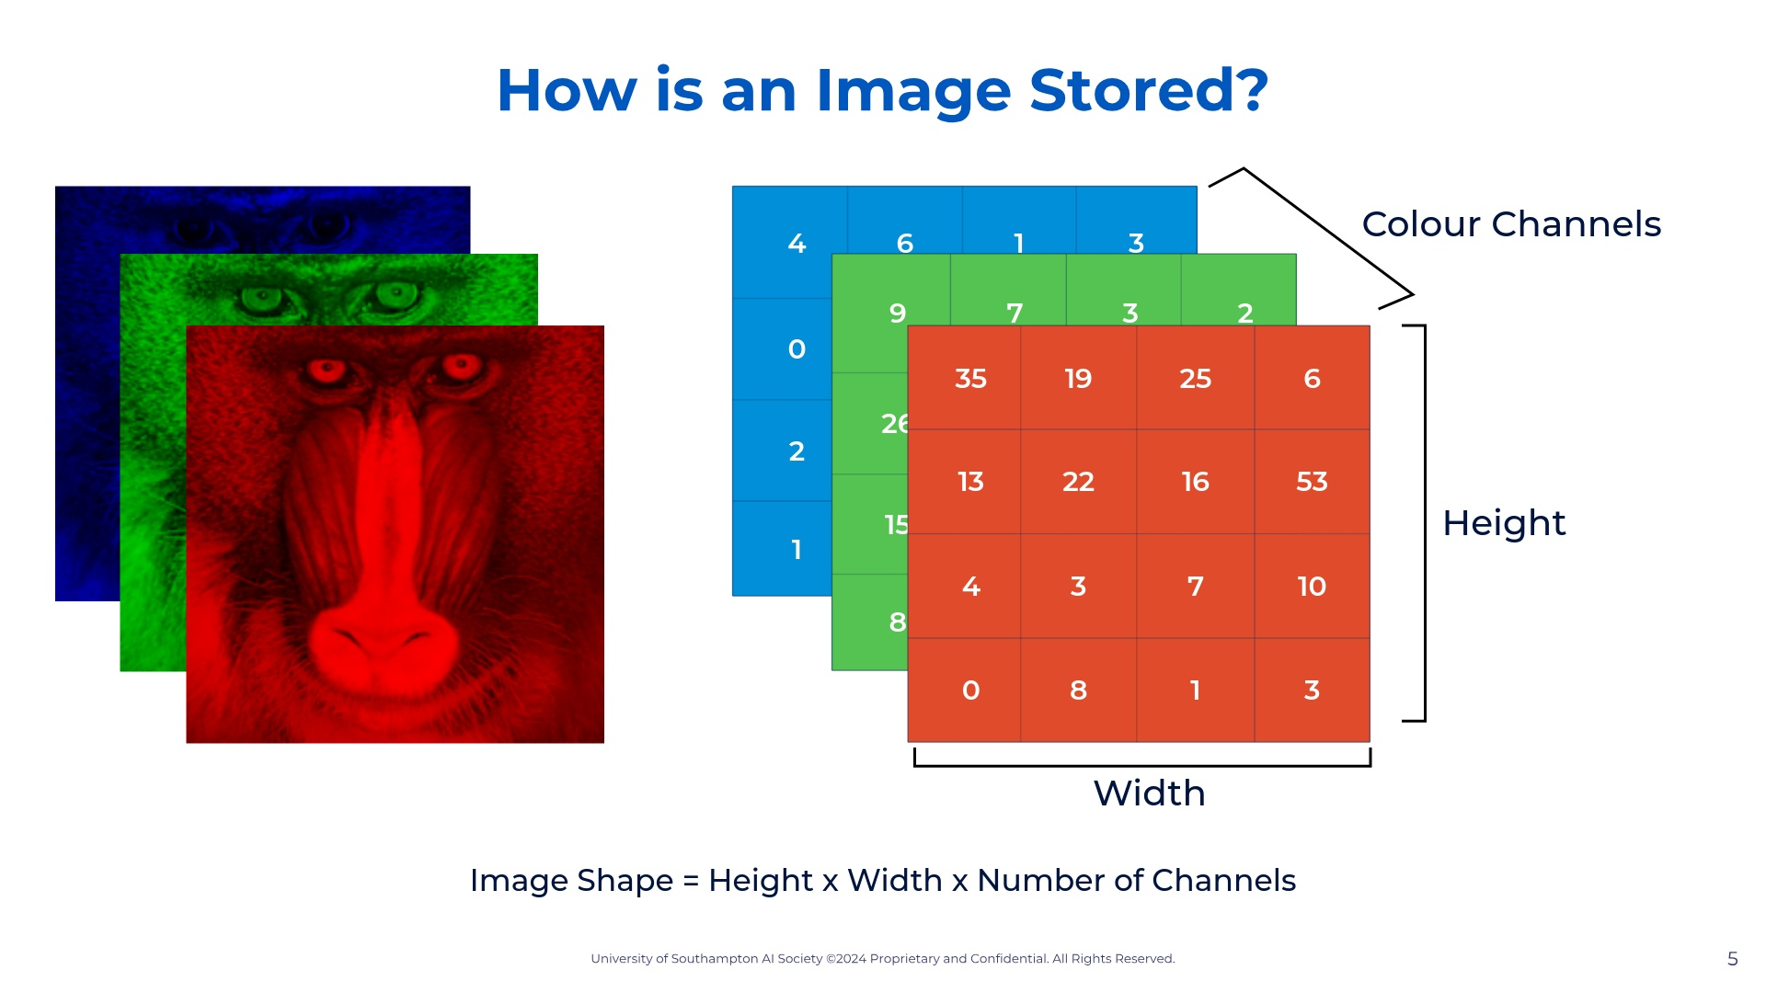
Notes:
So let's look at our dataset. This is the dataset's first rows taken from my command prompt when opening it. I'm showing it to you like this so you familiarize yourself. So we have our target variable which is survived. We can see it only stores 0 (died) and 1 (survived). So we know this is a classification model. We can also see our x-features, aka our x variables: Pclass, Name, Sex, Age, SibSp, Parch, Ticket, Fare, Cabin, Embarked. So now that we have defined our variables and the type of model we can start building our model. The model I chose for you was the logistic regression model as it is the starting point for classification models.

Slide 6


Slide 7
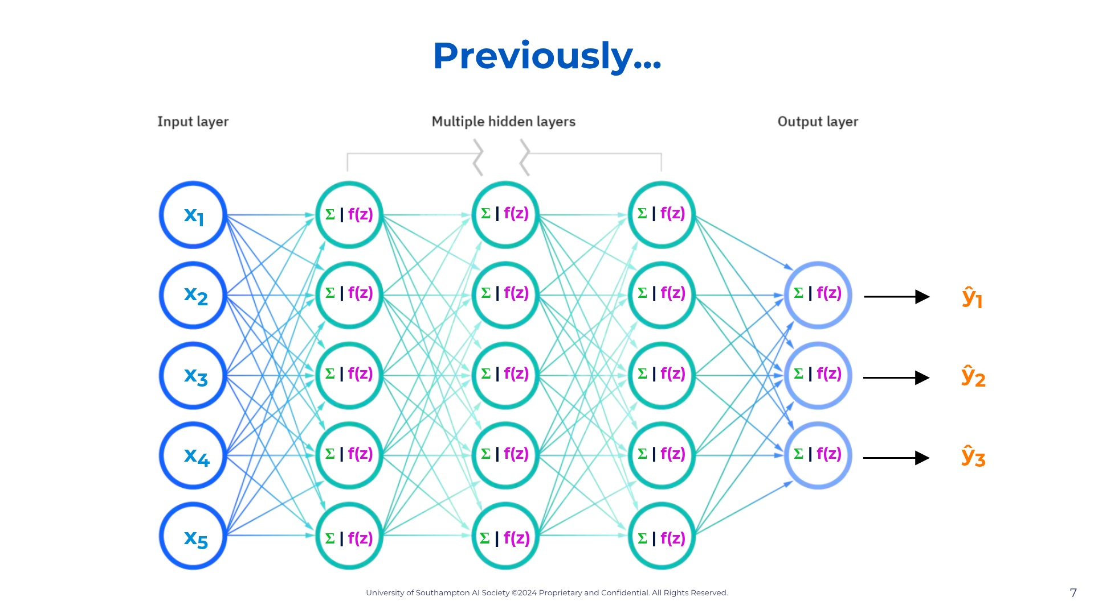
Notes:
— so in artificial neural networks, the ones we make in our computers, we have our input [indicate], our output [indicate], and our neurons in the middle that process what we inputted so then we can get a predicted output. Of course, just like in any ML algorithm we have a dataset with real x-value and their associated y-values. — So what neural networks do is the same thing as any other machine learning algorithm. It creates a function, using a dataset, that then can predict values. I had this misconception that NN were the best ML algorithm and the all-mighty powerful algorithm, but it's not. The most important thing to understand in ML is when to use what algorithms. For instance, ML is better for non-linear trends when comparing to the two regression algorithms we already talked about, because NN classify values and can process through much more data, while adapting by itself. Either way my goal for today is for you to understand the foundation of ML so then you can build off of this by yourselves much more easily. — Let's look at our diagram once more. So we have our input layer and each circle connects to each circle in the following layer. What that means is the data outputted from one circle is the next circles inputted data. In each circle the data is processed. Now the question is, what is this processing i'm talking about? What actually happens in each circle? Before we get into that let's define somethings.

Slide 8
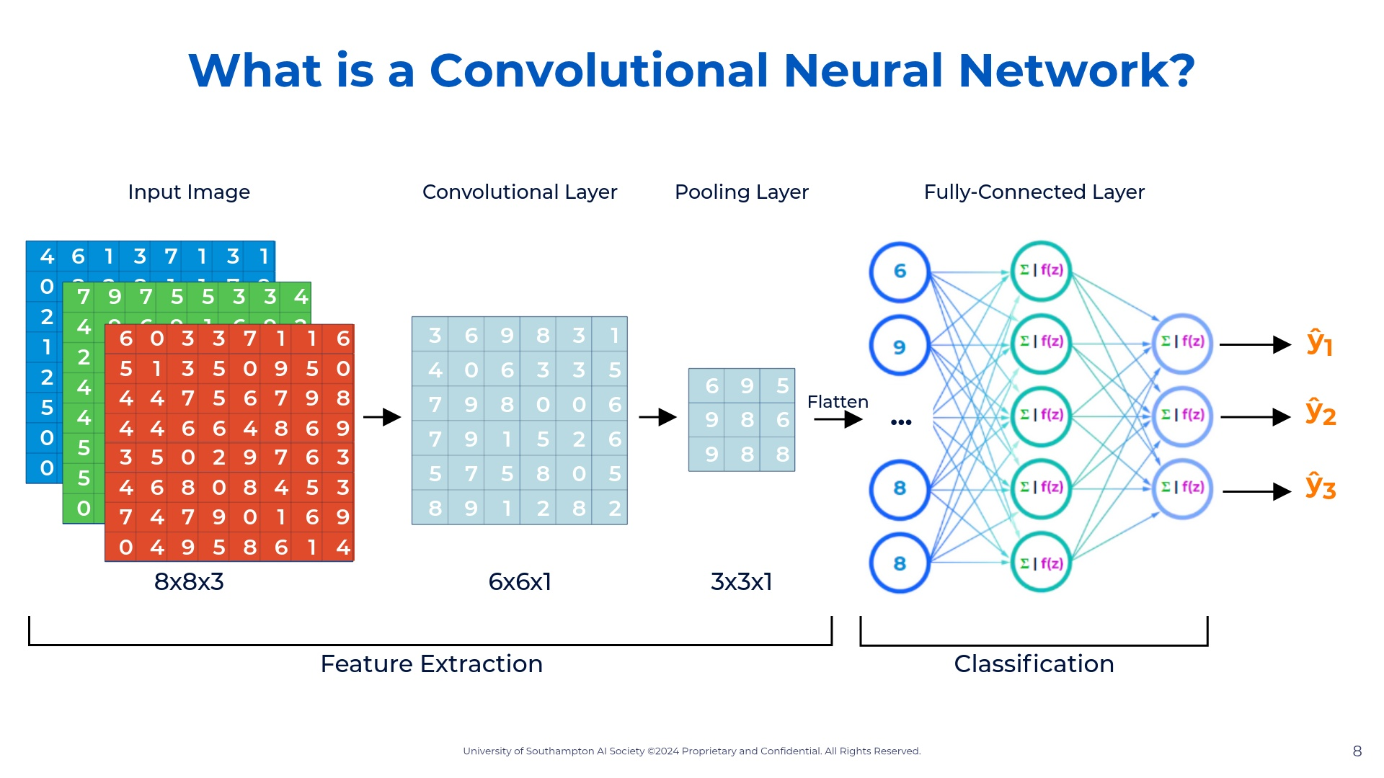
Notes:
So let's look at our dataset. This is the dataset's first rows taken from my command prompt when opening it. I'm showing it to you like this so you familiarize yourself. So we have our target variable which is survived. We can see it only stores 0 (died) and 1 (survived). So we know this is a classification model. We can also see our x-features, aka our x variables: Pclass, Name, Sex, Age, SibSp, Parch, Ticket, Fare, Cabin, Embarked. So now that we have defined our variables and the type of model we can start building our model. The model I chose for you was the logistic regression model as it is the starting point for classification models.

Slide 9
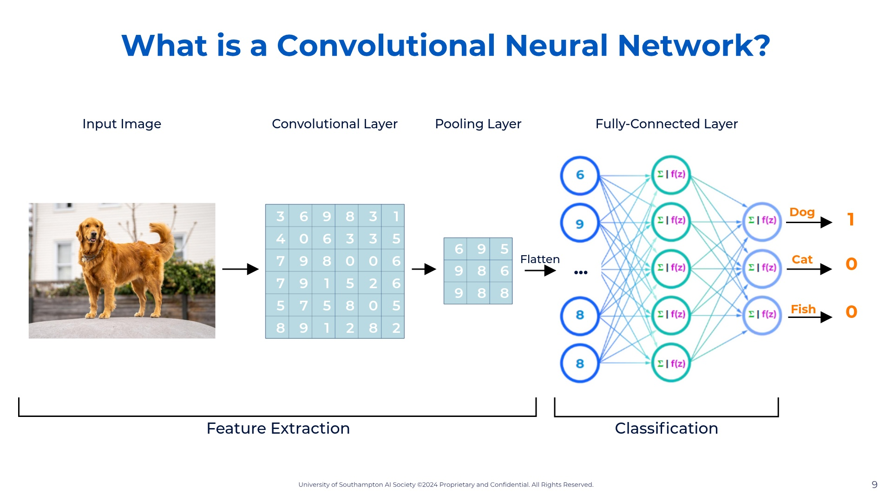
Notes:
So let's look at our dataset. This is the dataset's first rows taken from my command prompt when opening it. I'm showing it to you like this so you familiarize yourself. So we have our target variable which is survived. We can see it only stores 0 (died) and 1 (survived). So we know this is a classification model. We can also see our x-features, aka our x variables: Pclass, Name, Sex, Age, SibSp, Parch, Ticket, Fare, Cabin, Embarked. So now that we have defined our variables and the type of model we can start building our model. The model I chose for you was the logistic regression model as it is the starting point for classification models.

Slide 10


Slide 11
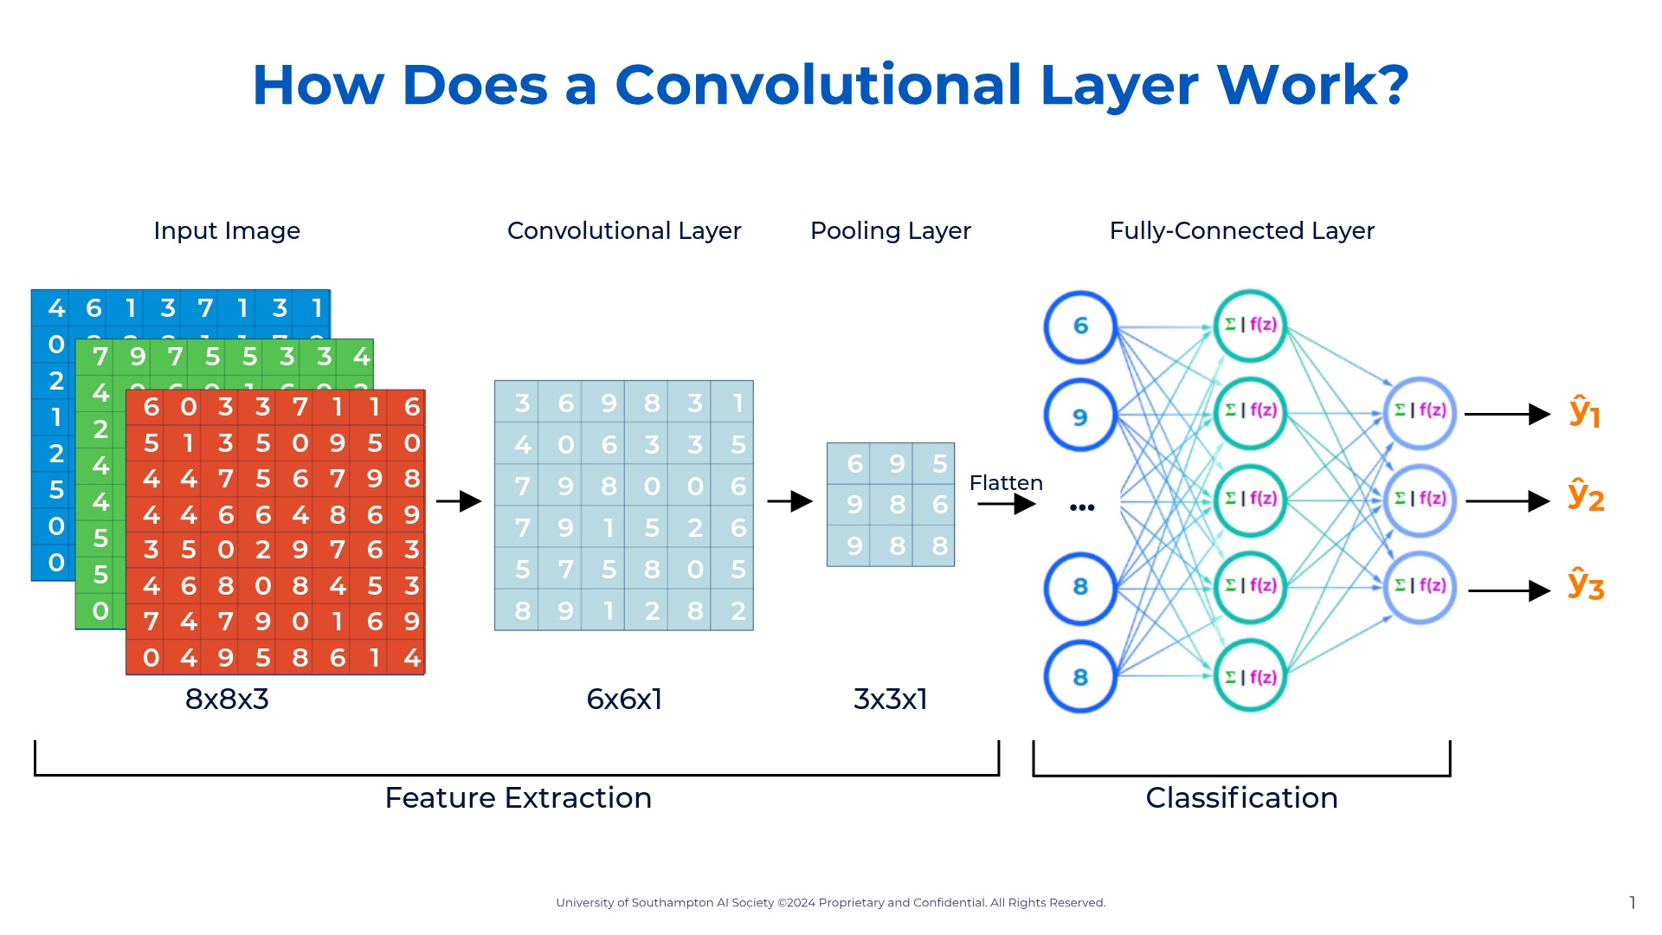
Notes:
So let's look at our dataset. This is the dataset's first rows taken from my command prompt when opening it. I'm showing it to you like this so you familiarize yourself. So we have our target variable which is survived. We can see it only stores 0 (died) and 1 (survived). So we know this is a classification model. We can also see our x-features, aka our x variables: Pclass, Name, Sex, Age, SibSp, Parch, Ticket, Fare, Cabin, Embarked. So now that we have defined our variables and the type of model we can start building our model. The model I chose for you was the logistic regression model as it is the starting point for classification models.

Slide 12
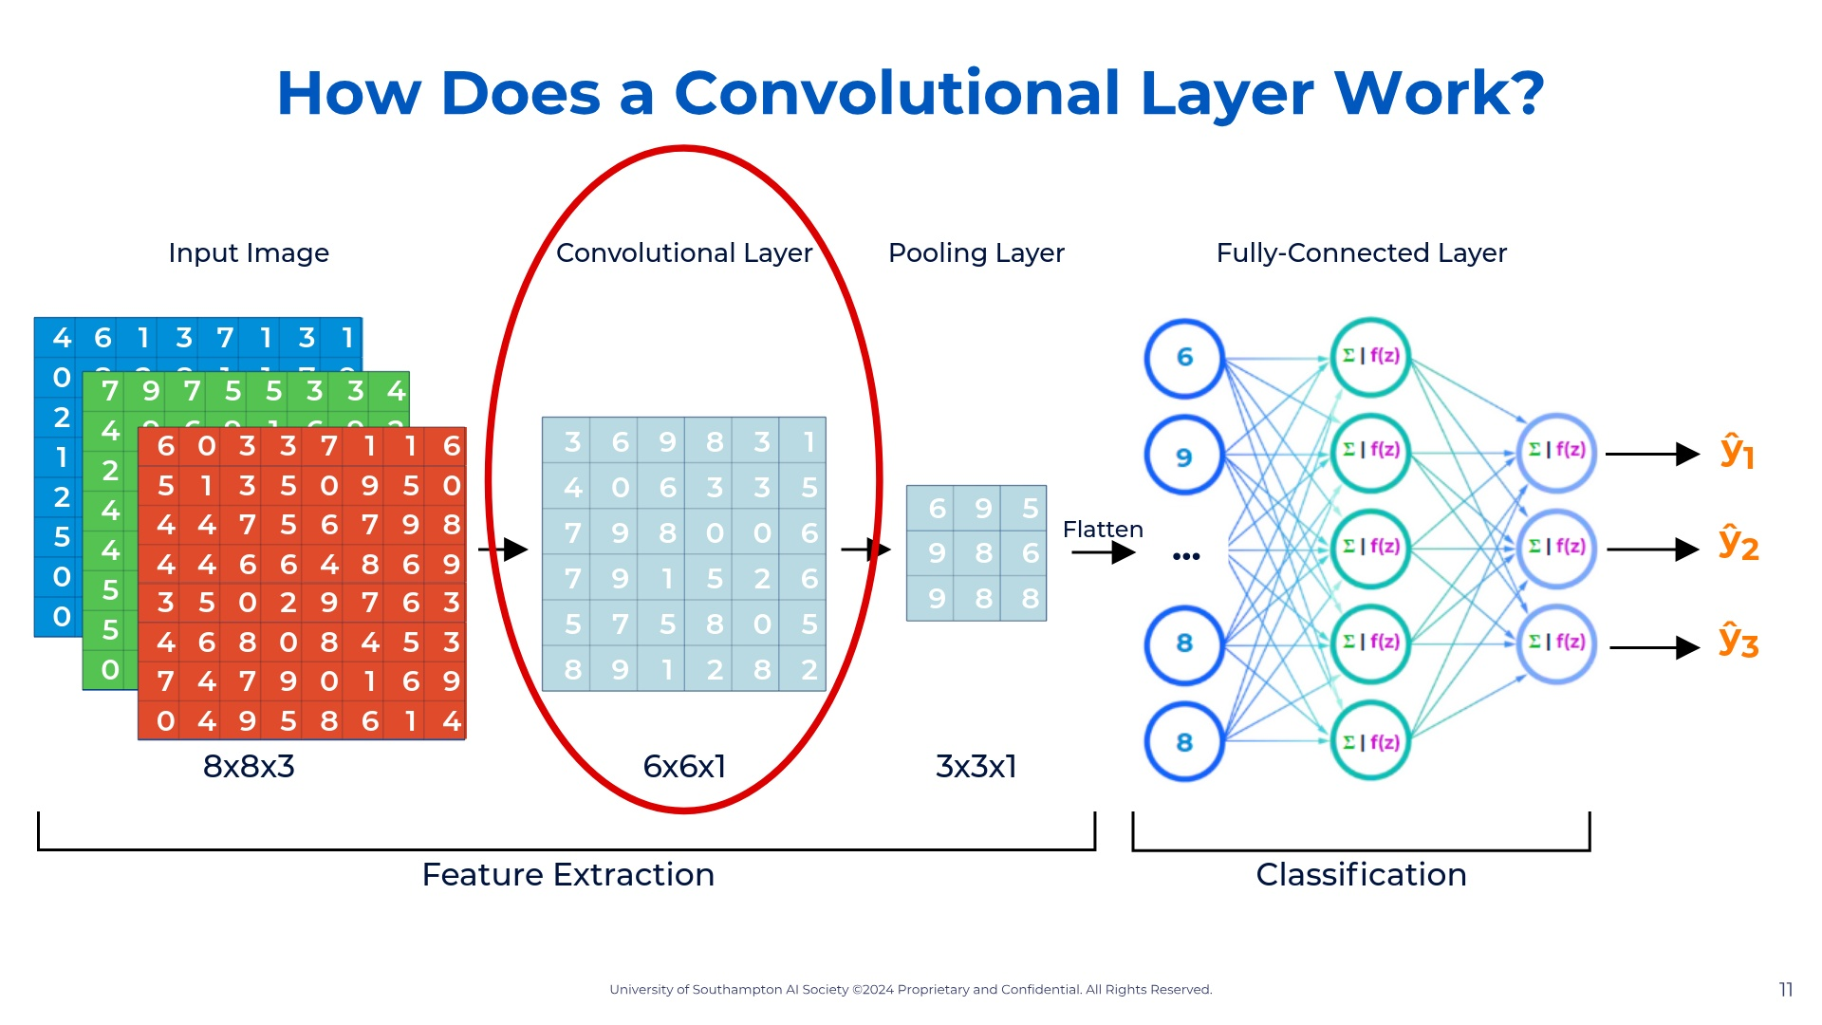
Notes:
So let's look at our dataset. This is the dataset's first rows taken from my command prompt when opening it. I'm showing it to you like this so you familiarize yourself. So we have our target variable which is survived. We can see it only stores 0 (died) and 1 (survived). So we know this is a classification model. We can also see our x-features, aka our x variables: Pclass, Name, Sex, Age, SibSp, Parch, Ticket, Fare, Cabin, Embarked. So now that we have defined our variables and the type of model we can start building our model. The model I chose for you was the logistic regression model as it is the starting point for classification models.

Slide 13
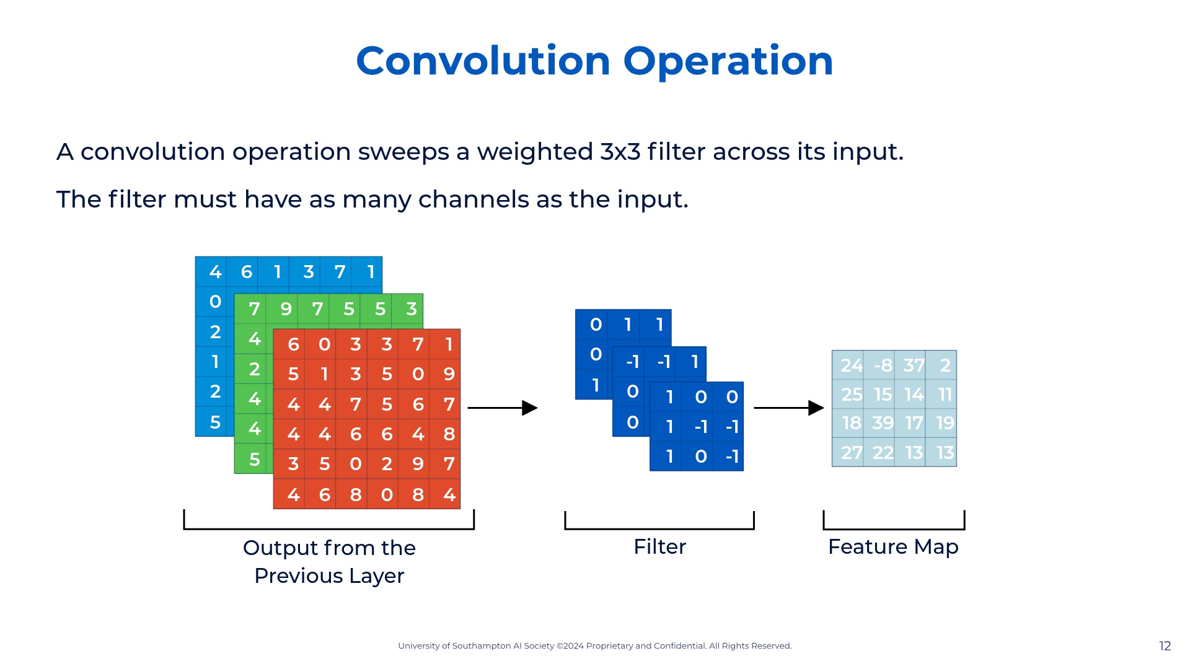
Notes:
So let's look at our dataset. This is the dataset's first rows taken from my command prompt when opening it. I'm showing it to you like this so you familiarize yourself. So we have our target variable which is survived. We can see it only stores 0 (died) and 1 (survived). So we know this is a classification model. We can also see our x-features, aka our x variables: Pclass, Name, Sex, Age, SibSp, Parch, Ticket, Fare, Cabin, Embarked. So now that we have defined our variables and the type of model we can start building our model. The model I chose for you was the logistic regression model as it is the starting point for classification models.

Slide 14
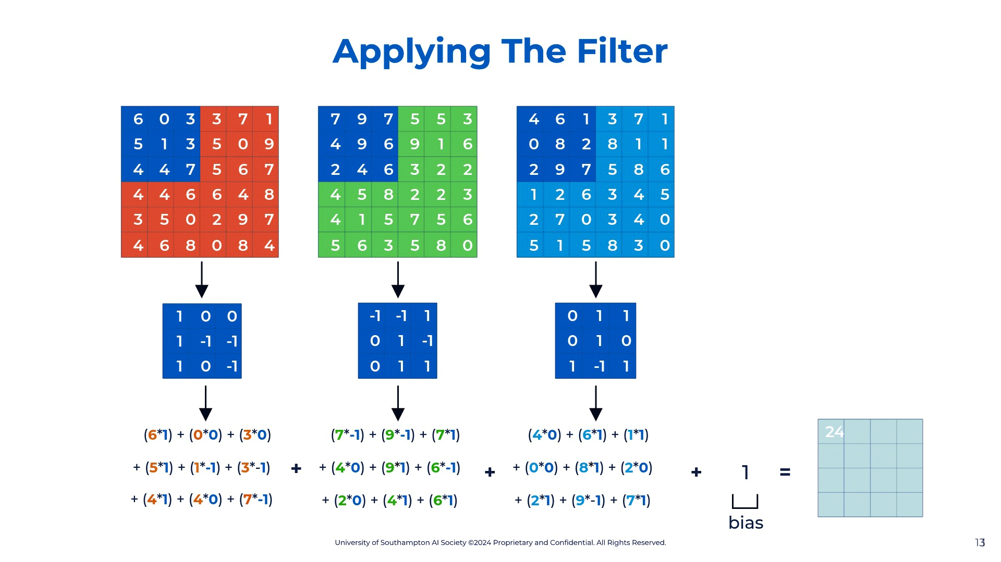
Notes:
So let's look at our dataset. This is the dataset's first rows taken from my command prompt when opening it. I'm showing it to you like this so you familiarize yourself. So we have our target variable which is survived. We can see it only stores 0 (died) and 1 (survived). So we know this is a classification model. We can also see our x-features, aka our x variables: Pclass, Name, Sex, Age, SibSp, Parch, Ticket, Fare, Cabin, Embarked. So now that we have defined our variables and the type of model we can start building our model. The model I chose for you was the logistic regression model as it is the starting point for classification models.

Slide 15

Notes:
So let's look at our dataset. This is the dataset's first rows taken from my command prompt when opening it. I'm showing it to you like this so you familiarize yourself. So we have our target variable which is survived. We can see it only stores 0 (died) and 1 (survived). So we know this is a classification model. We can also see our x-features, aka our x variables: Pclass, Name, Sex, Age, SibSp, Parch, Ticket, Fare, Cabin, Embarked. So now that we have defined our variables and the type of model we can start building our model. The model I chose for you was the logistic regression model as it is the starting point for classification models.

Slide 16
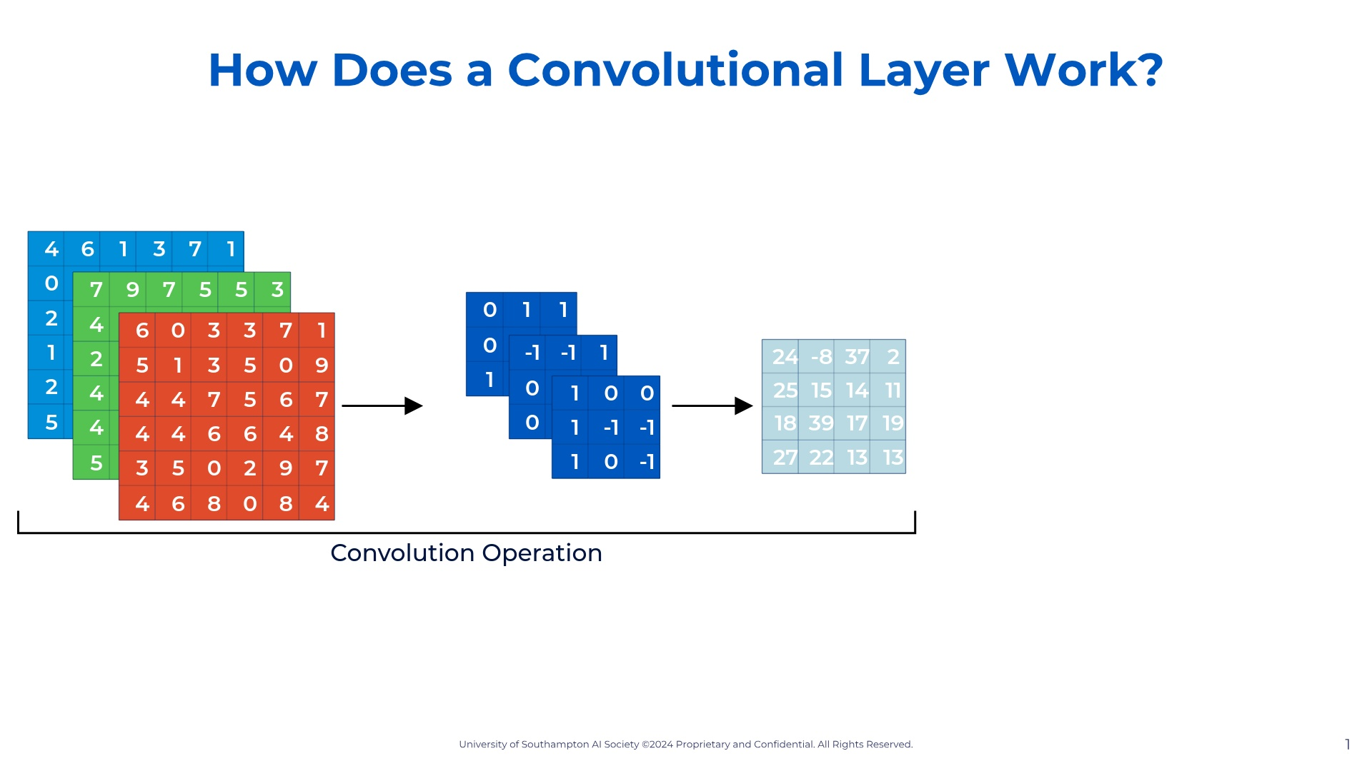
Notes:
So let's look at our dataset. This is the dataset's first rows taken from my command prompt when opening it. I'm showing it to you like this so you familiarize yourself. So we have our target variable which is survived. We can see it only stores 0 (died) and 1 (survived). So we know this is a classification model. We can also see our x-features, aka our x variables: Pclass, Name, Sex, Age, SibSp, Parch, Ticket, Fare, Cabin, Embarked. So now that we have defined our variables and the type of model we can start building our model. The model I chose for you was the logistic regression model as it is the starting point for classification models.

Slide 17
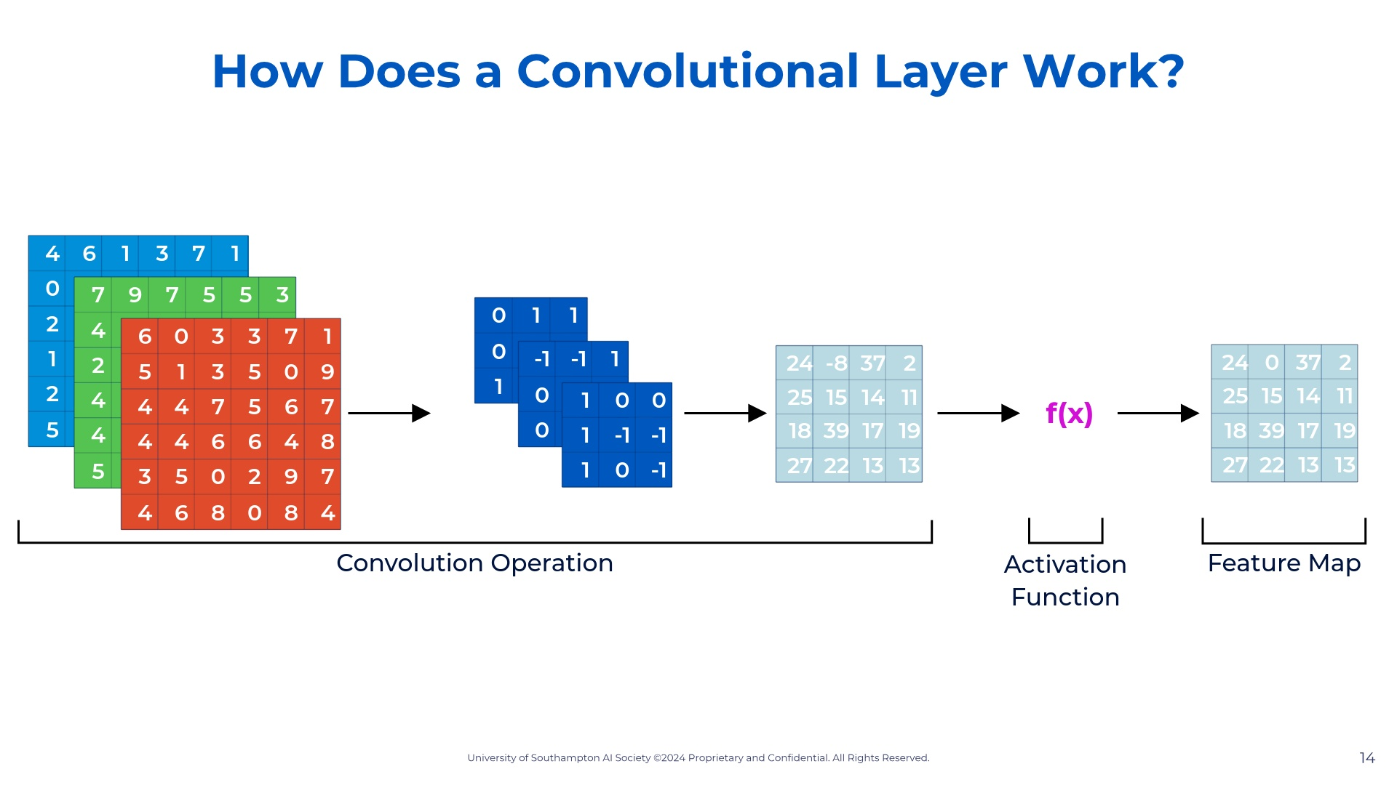
Notes:
So let's look at our dataset. This is the dataset's first rows taken from my command prompt when opening it. I'm showing it to you like this so you familiarize yourself. So we have our target variable which is survived. We can see it only stores 0 (died) and 1 (survived). So we know this is a classification model. We can also see our x-features, aka our x variables: Pclass, Name, Sex, Age, SibSp, Parch, Ticket, Fare, Cabin, Embarked. So now that we have defined our variables and the type of model we can start building our model. The model I chose for you was the logistic regression model as it is the starting point for classification models.

Slide 18
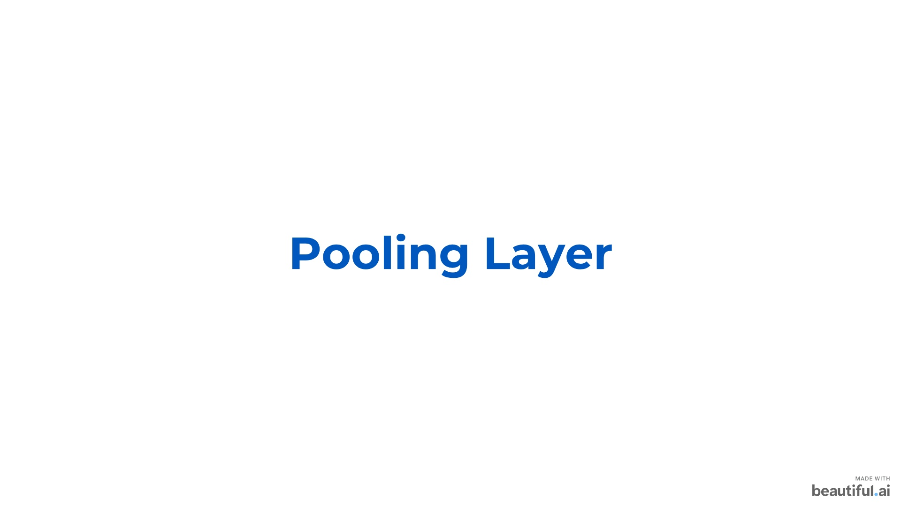

Slide 19
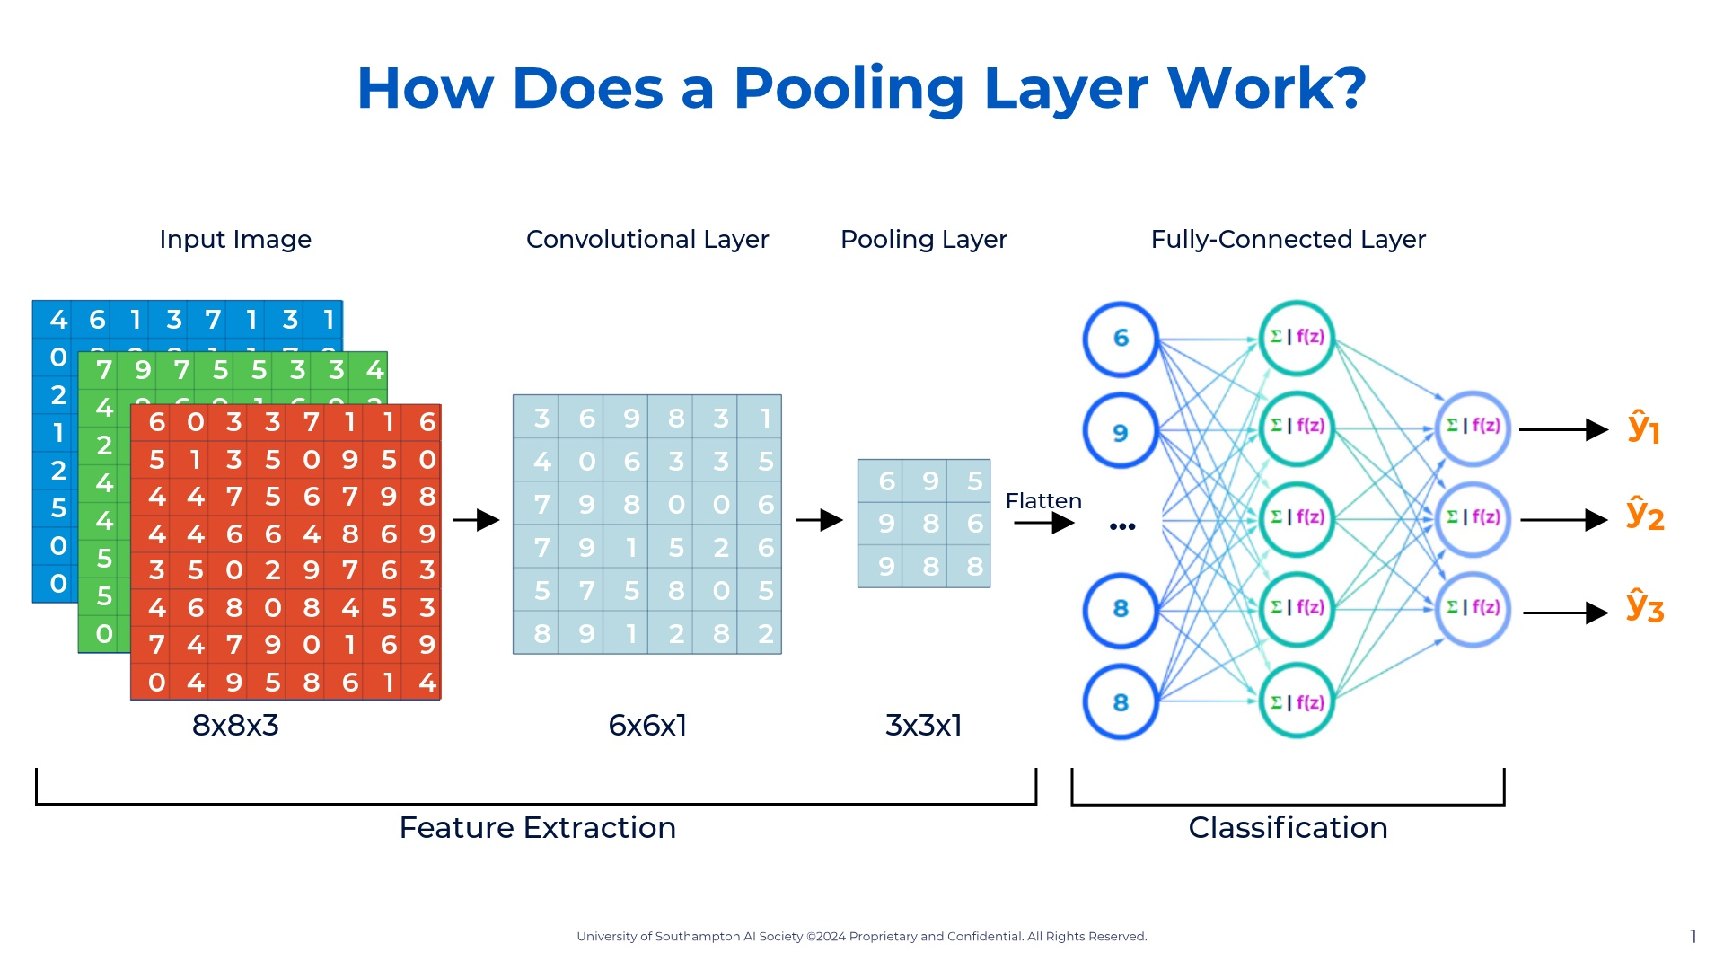
Notes:
So let's look at our dataset. This is the dataset's first rows taken from my command prompt when opening it. I'm showing it to you like this so you familiarize yourself. So we have our target variable which is survived. We can see it only stores 0 (died) and 1 (survived). So we know this is a classification model. We can also see our x-features, aka our x variables: Pclass, Name, Sex, Age, SibSp, Parch, Ticket, Fare, Cabin, Embarked. So now that we have defined our variables and the type of model we can start building our model. The model I chose for you was the logistic regression model as it is the starting point for classification models.

Slide 20
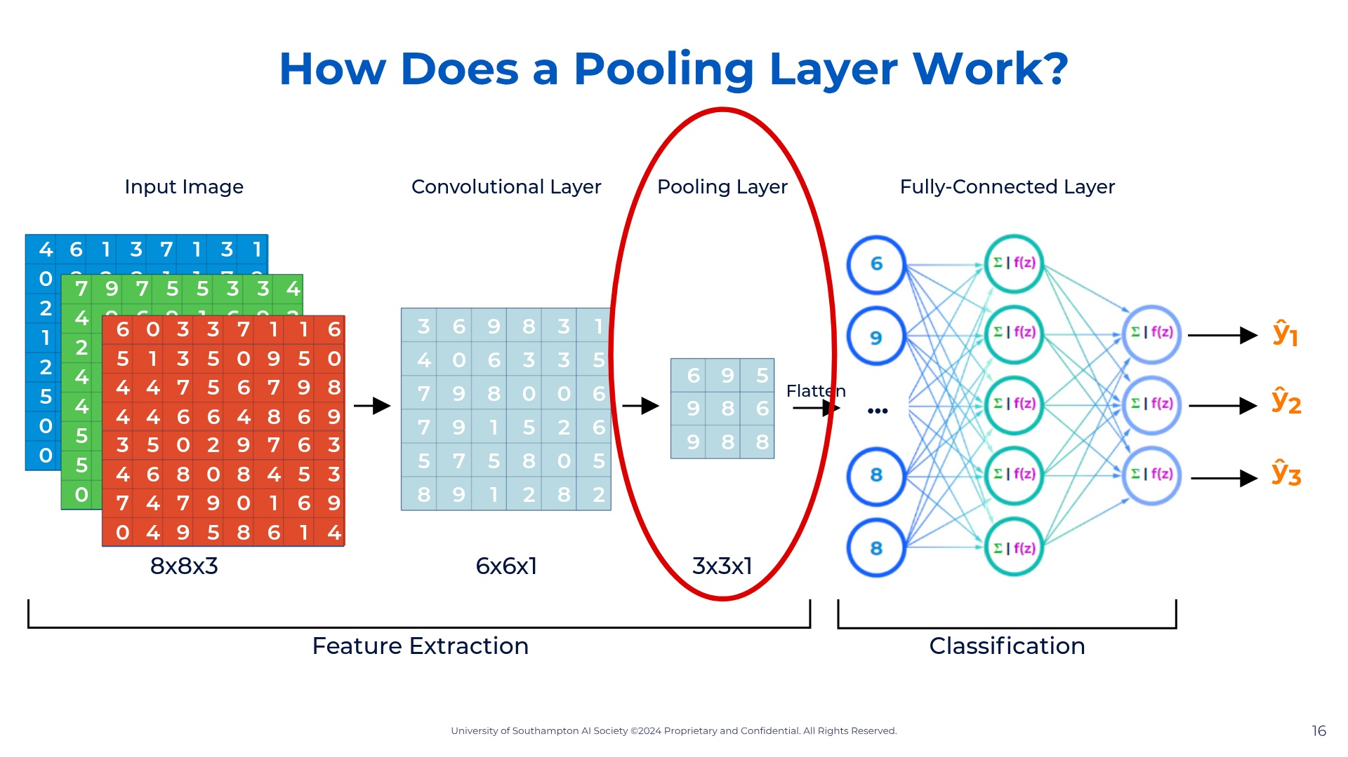
Notes:
So let's look at our dataset. This is the dataset's first rows taken from my command prompt when opening it. I'm showing it to you like this so you familiarize yourself. So we have our target variable which is survived. We can see it only stores 0 (died) and 1 (survived). So we know this is a classification model. We can also see our x-features, aka our x variables: Pclass, Name, Sex, Age, SibSp, Parch, Ticket, Fare, Cabin, Embarked. So now that we have defined our variables and the type of model we can start building our model. The model I chose for you was the logistic regression model as it is the starting point for classification models.

Slide 21
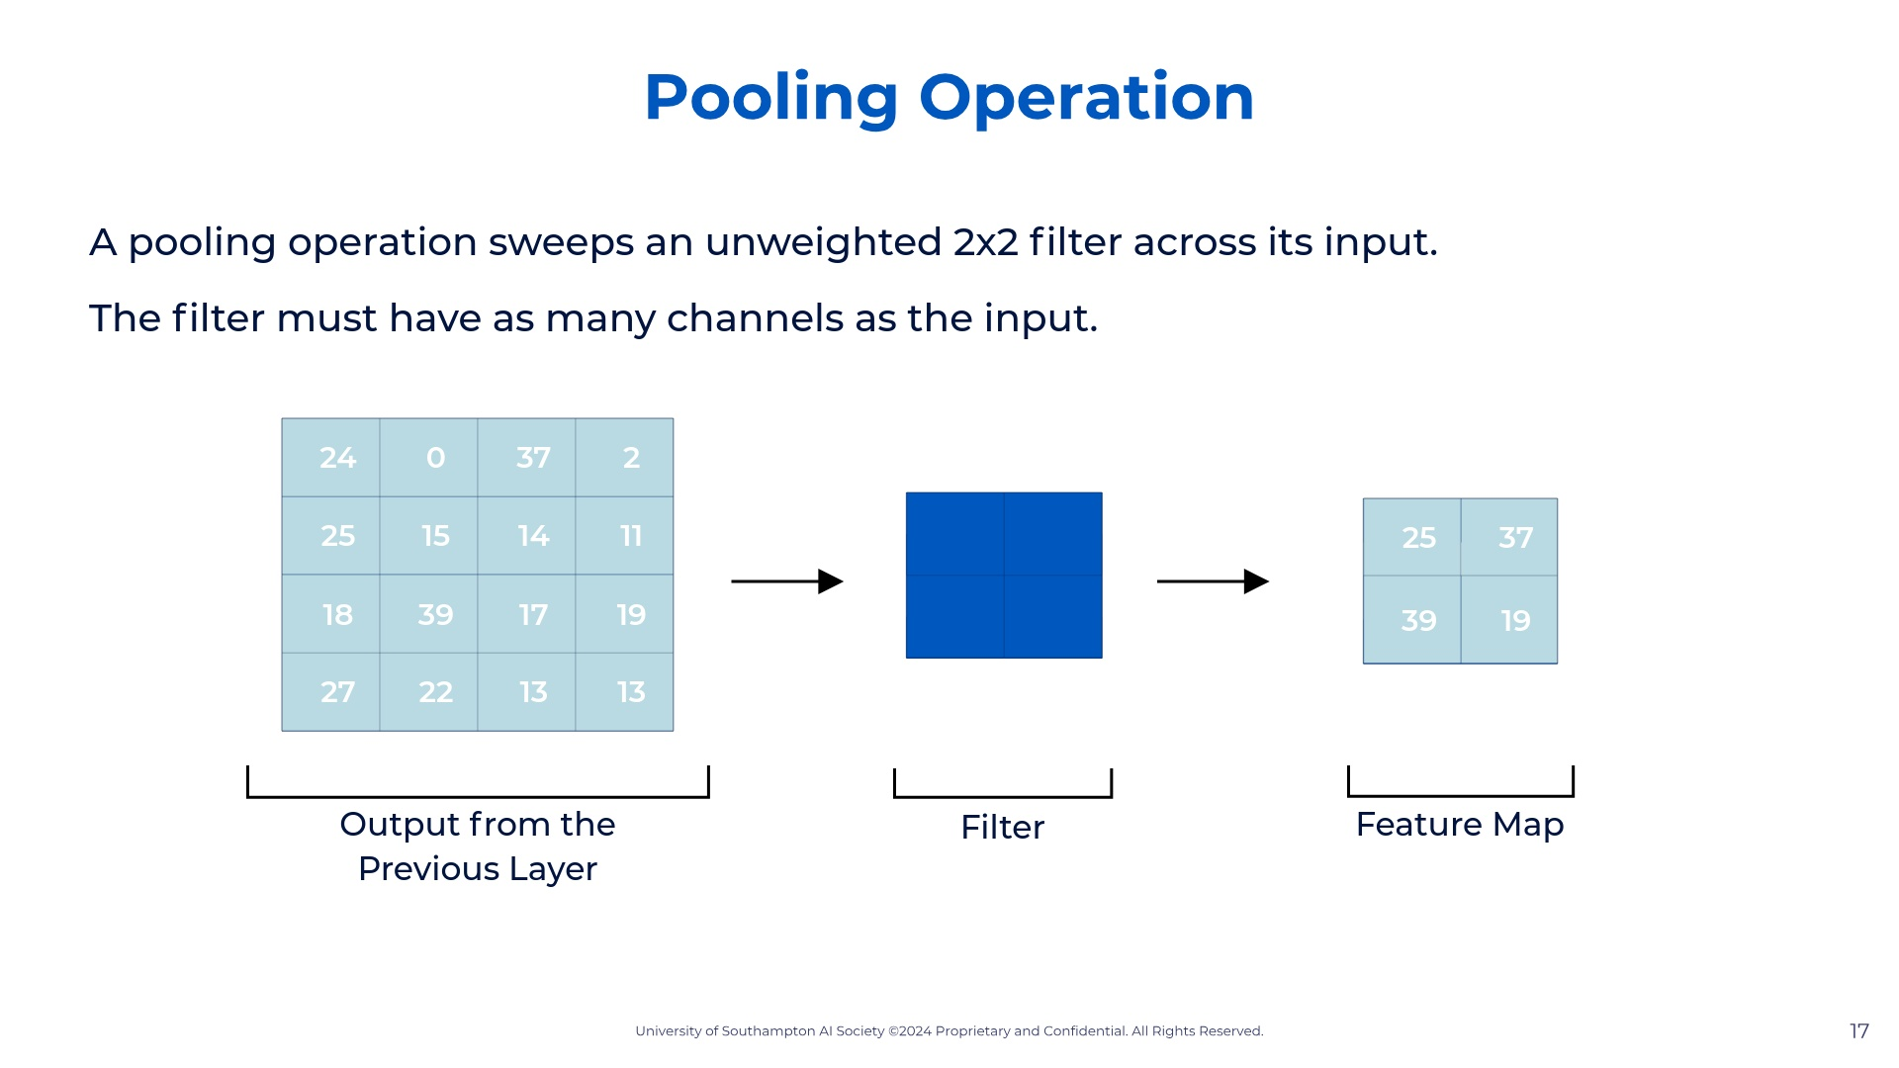
Notes:
So let's look at our dataset. This is the dataset's first rows taken from my command prompt when opening it. I'm showing it to you like this so you familiarize yourself. So we have our target variable which is survived. We can see it only stores 0 (died) and 1 (survived). So we know this is a classification model. We can also see our x-features, aka our x variables: Pclass, Name, Sex, Age, SibSp, Parch, Ticket, Fare, Cabin, Embarked. So now that we have defined our variables and the type of model we can start building our model. The model I chose for you was the logistic regression model as it is the starting point for classification models.

Slide 22
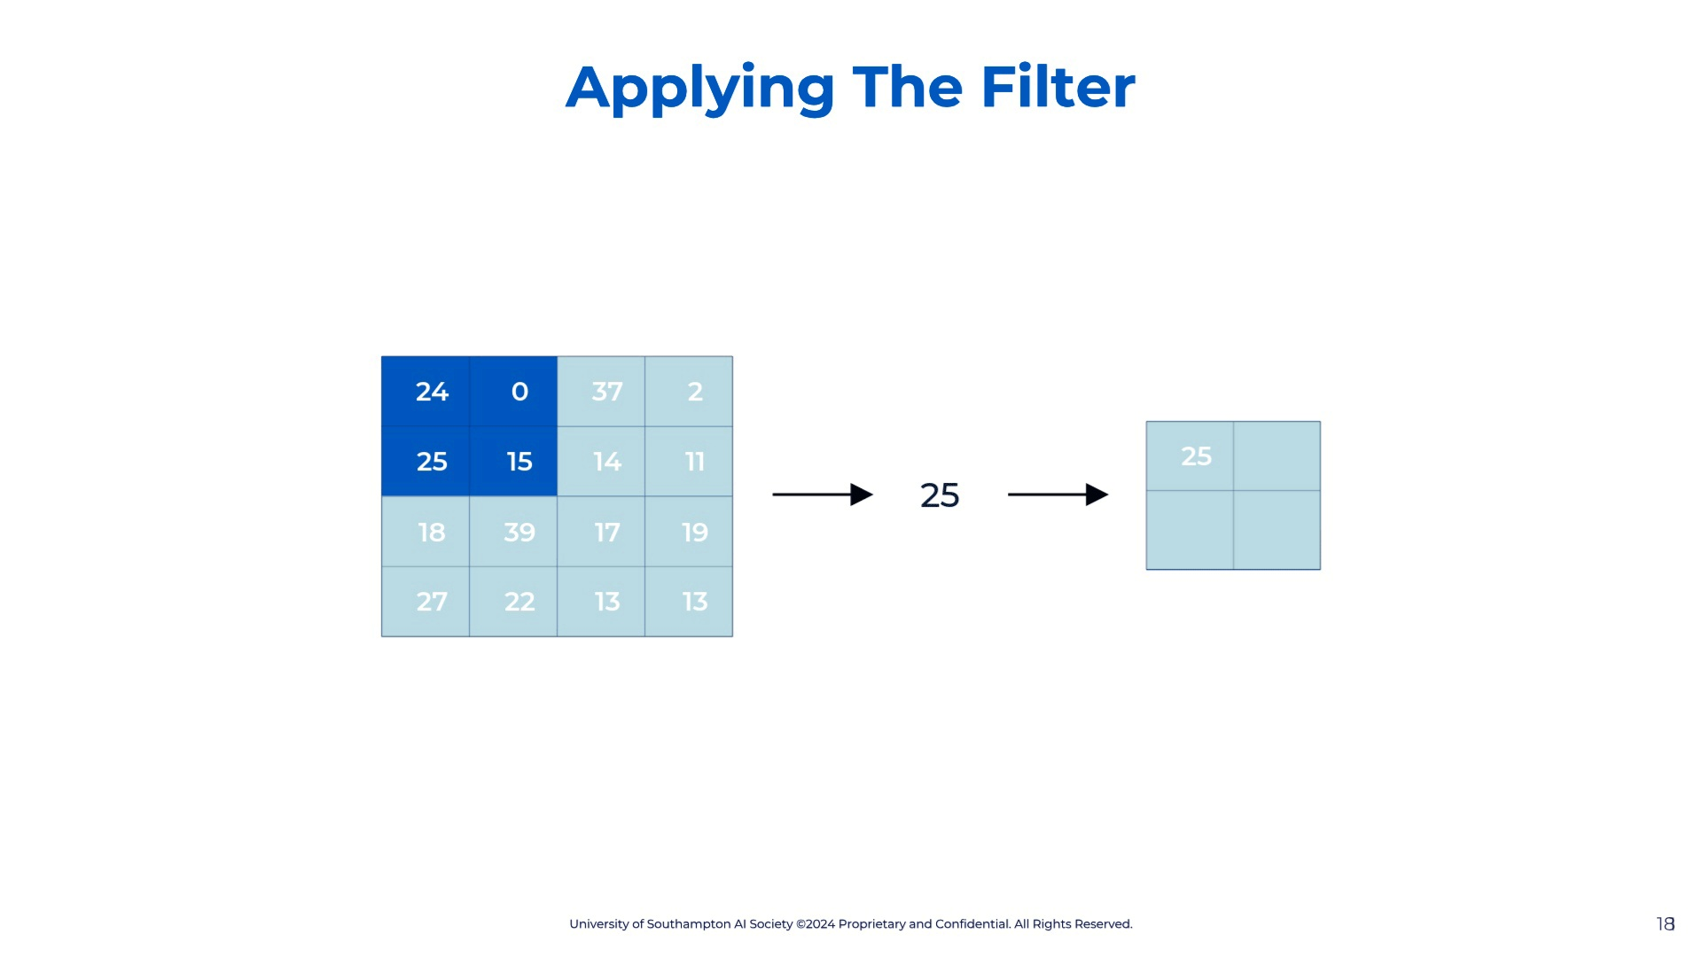
Notes:
So let's look at our dataset. This is the dataset's first rows taken from my command prompt when opening it. I'm showing it to you like this so you familiarize yourself. So we have our target variable which is survived. We can see it only stores 0 (died) and 1 (survived). So we know this is a classification model. We can also see our x-features, aka our x variables: Pclass, Name, Sex, Age, SibSp, Parch, Ticket, Fare, Cabin, Embarked. So now that we have defined our variables and the type of model we can start building our model. The model I chose for you was the logistic regression model as it is the starting point for classification models.

Slide 23
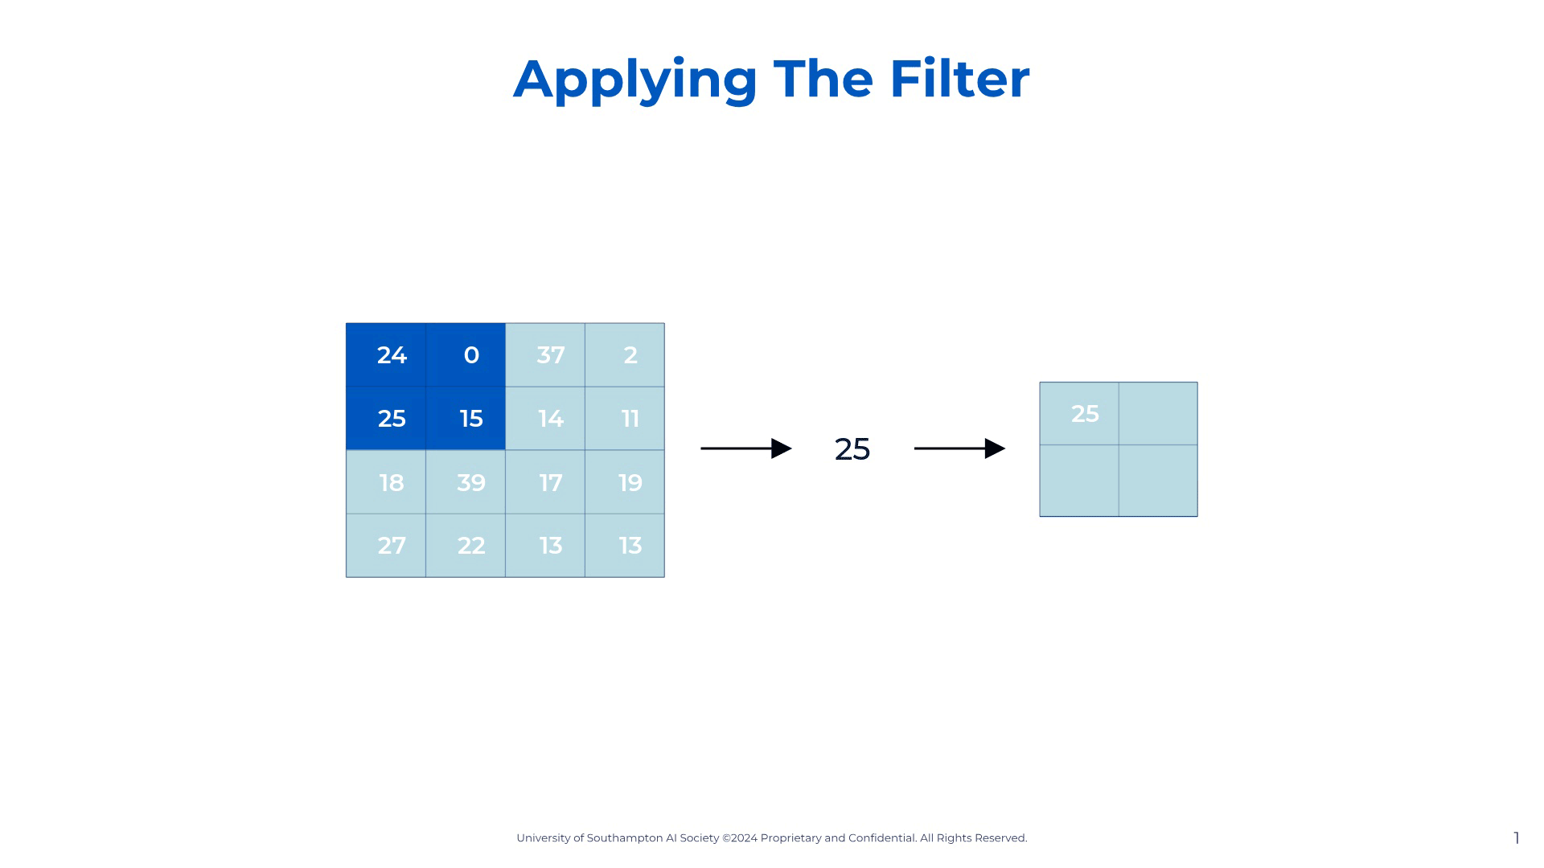
Notes:
So let's look at our dataset. This is the dataset's first rows taken from my command prompt when opening it. I'm showing it to you like this so you familiarize yourself. So we have our target variable which is survived. We can see it only stores 0 (died) and 1 (survived). So we know this is a classification model. We can also see our x-features, aka our x variables: Pclass, Name, Sex, Age, SibSp, Parch, Ticket, Fare, Cabin, Embarked. So now that we have defined our variables and the type of model we can start building our model. The model I chose for you was the logistic regression model as it is the starting point for classification models.

Slide 24
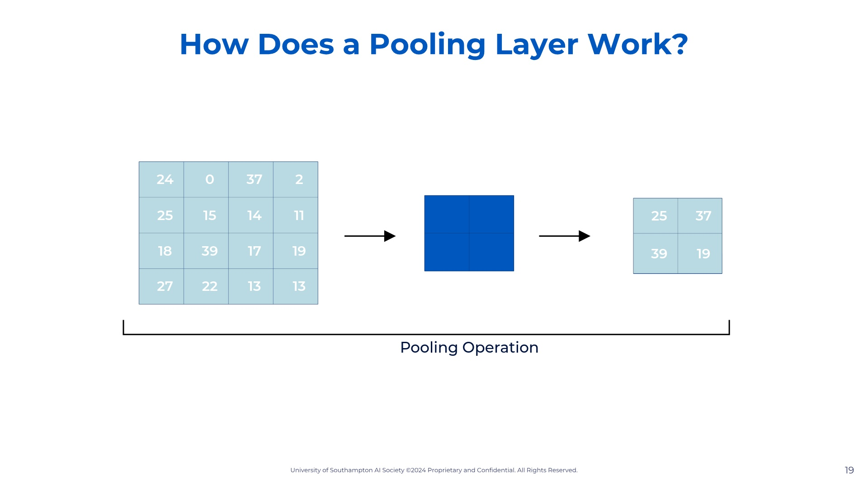
Notes:
So let's look at our dataset. This is the dataset's first rows taken from my command prompt when opening it. I'm showing it to you like this so you familiarize yourself. So we have our target variable which is survived. We can see it only stores 0 (died) and 1 (survived). So we know this is a classification model. We can also see our x-features, aka our x variables: Pclass, Name, Sex, Age, SibSp, Parch, Ticket, Fare, Cabin, Embarked. So now that we have defined our variables and the type of model we can start building our model. The model I chose for you was the logistic regression model as it is the starting point for classification models.

Slide 25


Slide 26


Slide 27
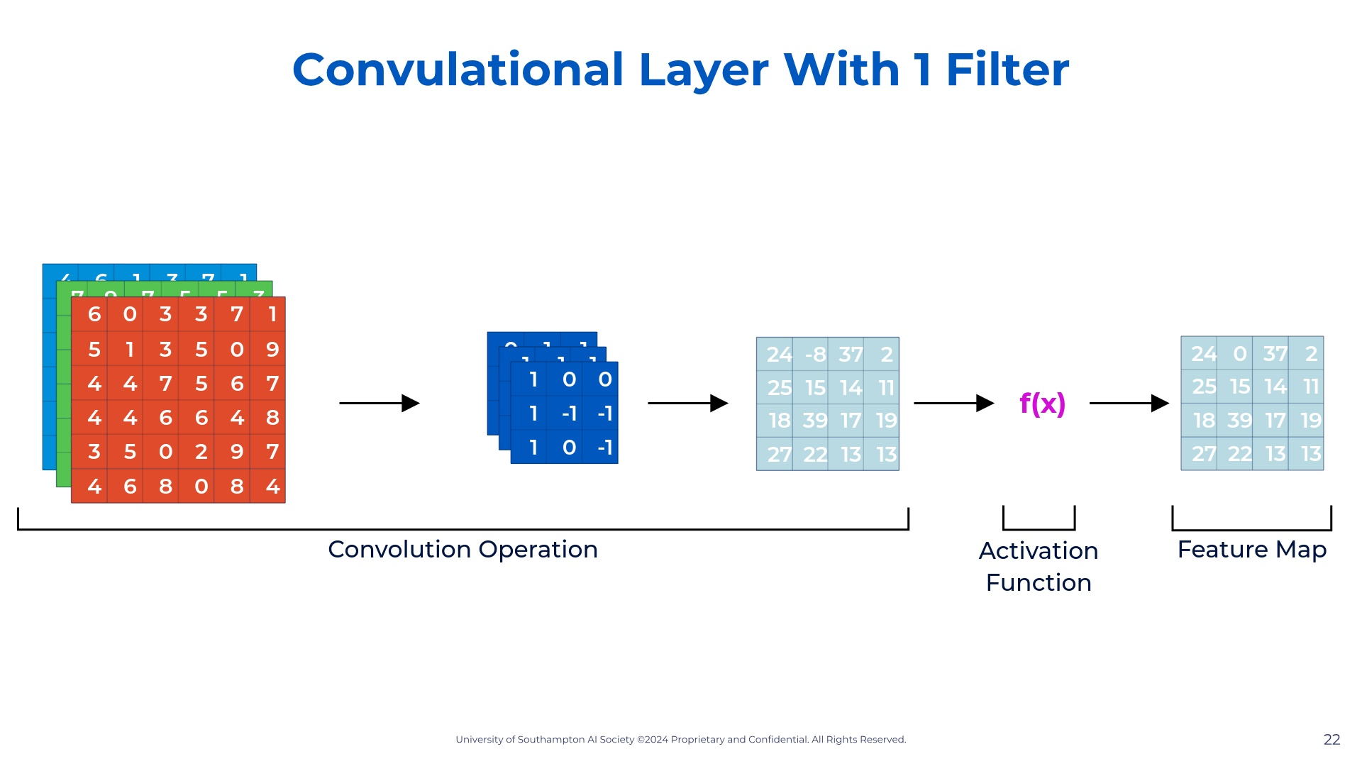
Notes:
So let's look at our dataset. This is the dataset's first rows taken from my command prompt when opening it. I'm showing it to you like this so you familiarize yourself. So we have our target variable which is survived. We can see it only stores 0 (died) and 1 (survived). So we know this is a classification model. We can also see our x-features, aka our x variables: Pclass, Name, Sex, Age, SibSp, Parch, Ticket, Fare, Cabin, Embarked. So now that we have defined our variables and the type of model we can start building our model. The model I chose for you was the logistic regression model as it is the starting point for classification models.

Slide 28
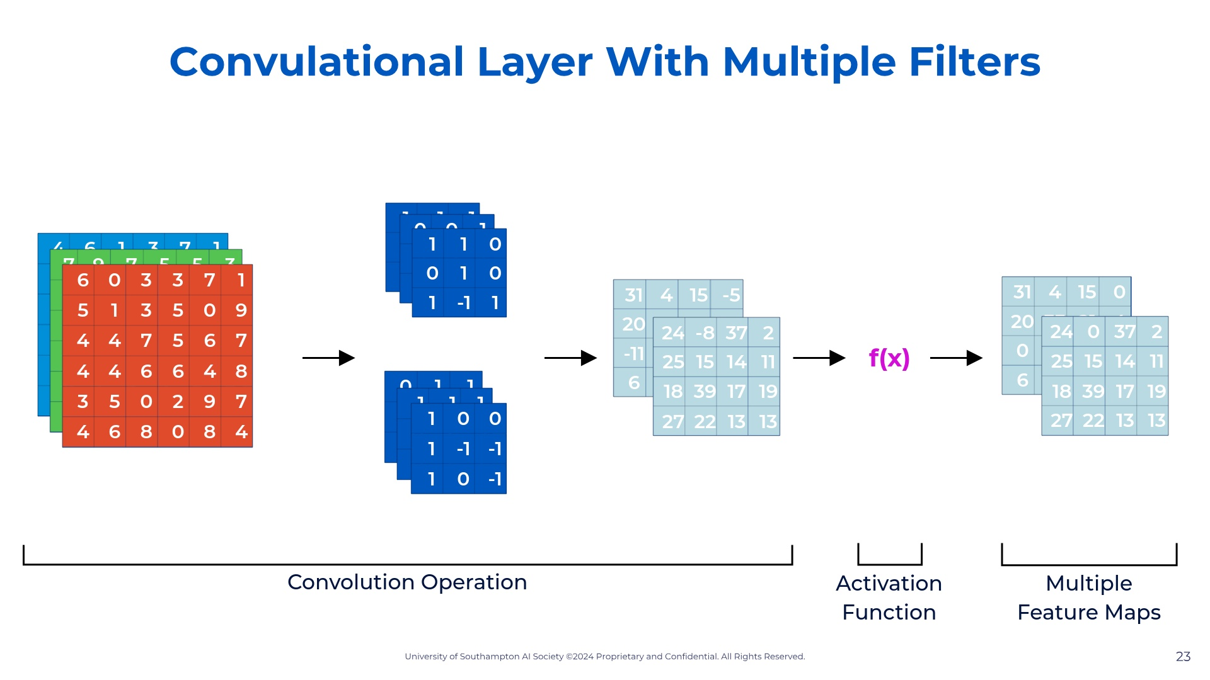
Notes:
So let's look at our dataset. This is the dataset's first rows taken from my command prompt when opening it. I'm showing it to you like this so you familiarize yourself. So we have our target variable which is survived. We can see it only stores 0 (died) and 1 (survived). So we know this is a classification model. We can also see our x-features, aka our x variables: Pclass, Name, Sex, Age, SibSp, Parch, Ticket, Fare, Cabin, Embarked. So now that we have defined our variables and the type of model we can start building our model. The model I chose for you was the logistic regression model as it is the starting point for classification models.

Slide 29
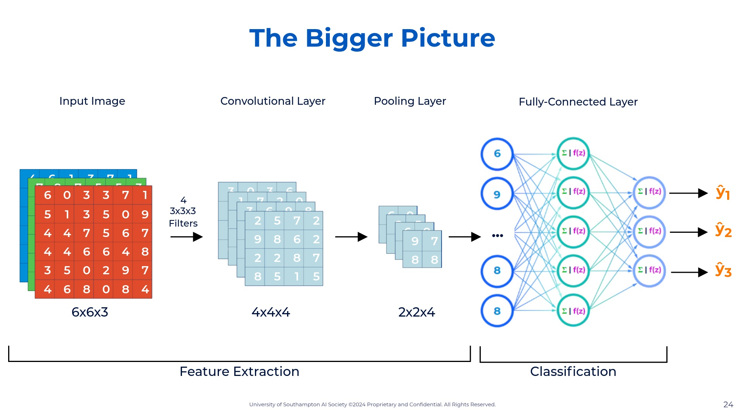
Notes:
So let's look at our dataset. This is the dataset's first rows taken from my command prompt when opening it. I'm showing it to you like this so you familiarize yourself. So we have our target variable which is survived. We can see it only stores 0 (died) and 1 (survived). So we know this is a classification model. We can also see our x-features, aka our x variables: Pclass, Name, Sex, Age, SibSp, Parch, Ticket, Fare, Cabin, Embarked. So now that we have defined our variables and the type of model we can start building our model. The model I chose for you was the logistic regression model as it is the starting point for classification models.

Slide 30
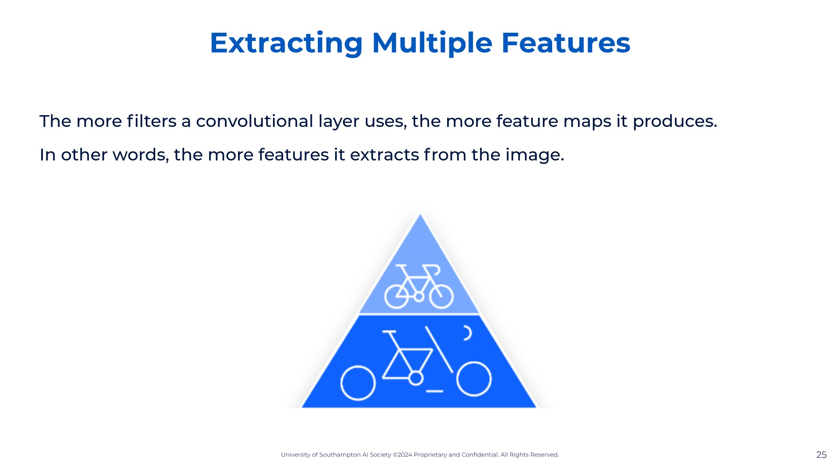
Notes:
So let's look at our dataset. This is the dataset's first rows taken from my command prompt when opening it. I'm showing it to you like this so you familiarize yourself. So we have our target variable which is survived. We can see it only stores 0 (died) and 1 (survived). So we know this is a classification model. We can also see our x-features, aka our x variables: Pclass, Name, Sex, Age, SibSp, Parch, Ticket, Fare, Cabin, Embarked. So now that we have defined our variables and the type of model we can start building our model. The model I chose for you was the logistic regression model as it is the starting point for classification models.

Slide 31


Slide 32
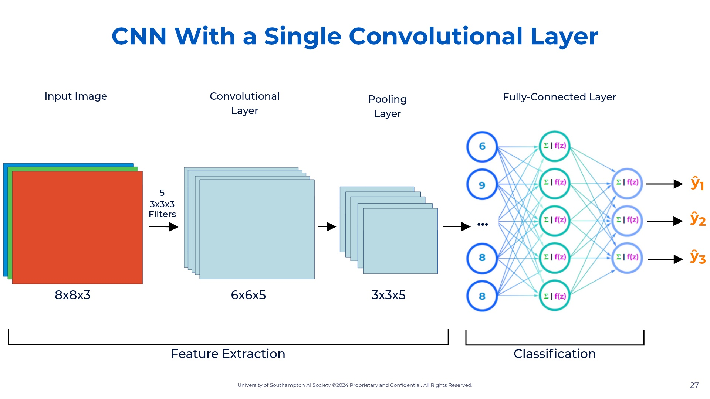
Notes:
So let's look at our dataset. This is the dataset's first rows taken from my command prompt when opening it. I'm showing it to you like this so you familiarize yourself. So we have our target variable which is survived. We can see it only stores 0 (died) and 1 (survived). So we know this is a classification model. We can also see our x-features, aka our x variables: Pclass, Name, Sex, Age, SibSp, Parch, Ticket, Fare, Cabin, Embarked. So now that we have defined our variables and the type of model we can start building our model. The model I chose for you was the logistic regression model as it is the starting point for classification models.

Slide 33
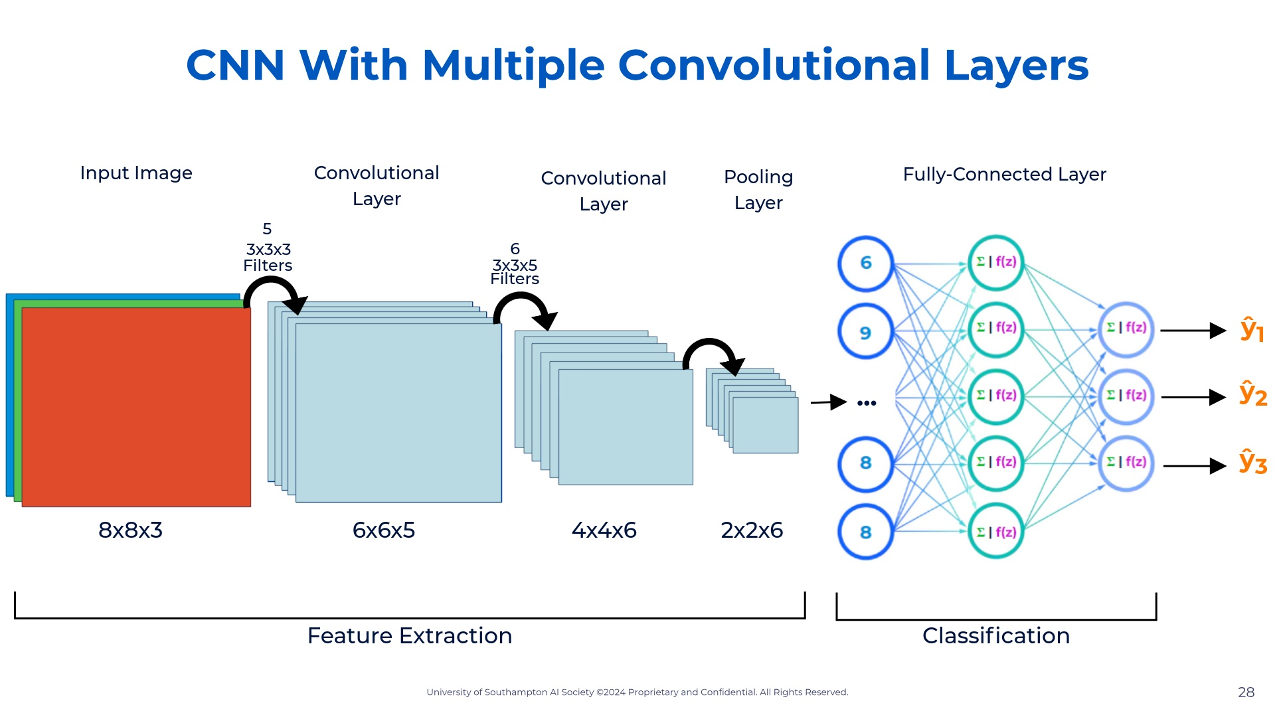
Notes:
So let's look at our dataset. This is the dataset's first rows taken from my command prompt when opening it. I'm showing it to you like this so you familiarize yourself. So we have our target variable which is survived. We can see it only stores 0 (died) and 1 (survived). So we know this is a classification model. We can also see our x-features, aka our x variables: Pclass, Name, Sex, Age, SibSp, Parch, Ticket, Fare, Cabin, Embarked. So now that we have defined our variables and the type of model we can start building our model. The model I chose for you was the logistic regression model as it is the starting point for classification models.

Slide 34
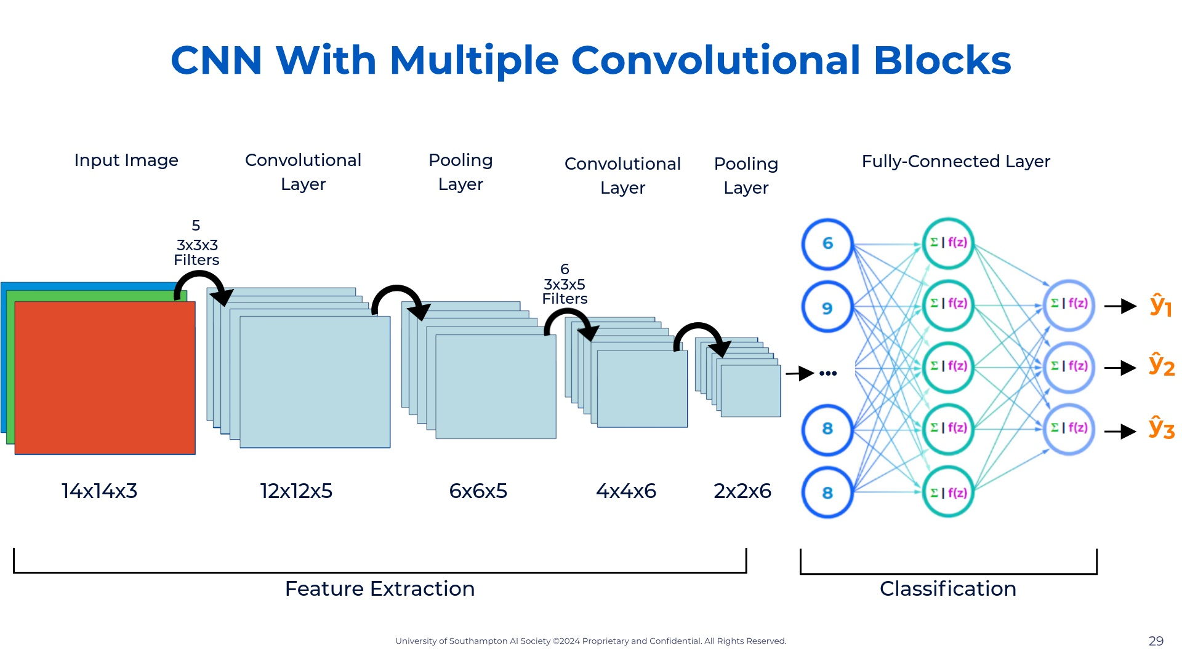
Notes:
So let's look at our dataset. This is the dataset's first rows taken from my command prompt when opening it. I'm showing it to you like this so you familiarize yourself. So we have our target variable which is survived. We can see it only stores 0 (died) and 1 (survived). So we know this is a classification model. We can also see our x-features, aka our x variables: Pclass, Name, Sex, Age, SibSp, Parch, Ticket, Fare, Cabin, Embarked. So now that we have defined our variables and the type of model we can start building our model. The model I chose for you was the logistic regression model as it is the starting point for classification models.

Slide 35
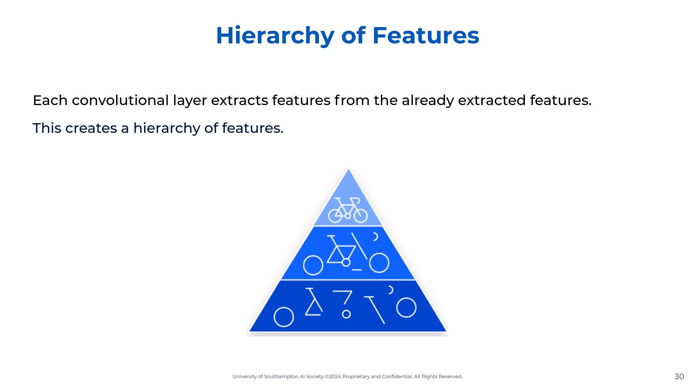
Notes:
So let's look at our dataset. This is the dataset's first rows taken from my command prompt when opening it. I'm showing it to you like this so you familiarize yourself. So we have our target variable which is survived. We can see it only stores 0 (died) and 1 (survived). So we know this is a classification model. We can also see our x-features, aka our x variables: Pclass, Name, Sex, Age, SibSp, Parch, Ticket, Fare, Cabin, Embarked. So now that we have defined our variables and the type of model we can start building our model. The model I chose for you was the logistic regression model as it is the starting point for classification models.

Slide 36
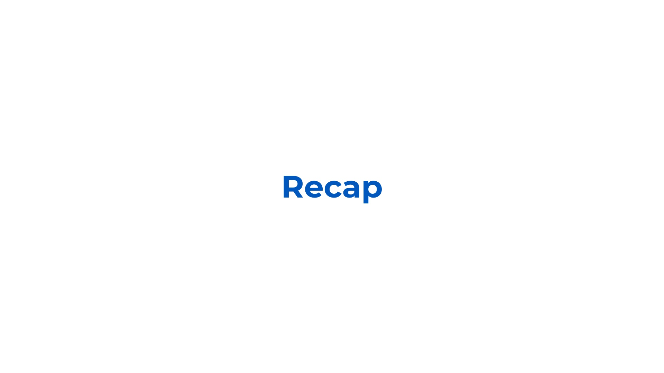

Slide 37
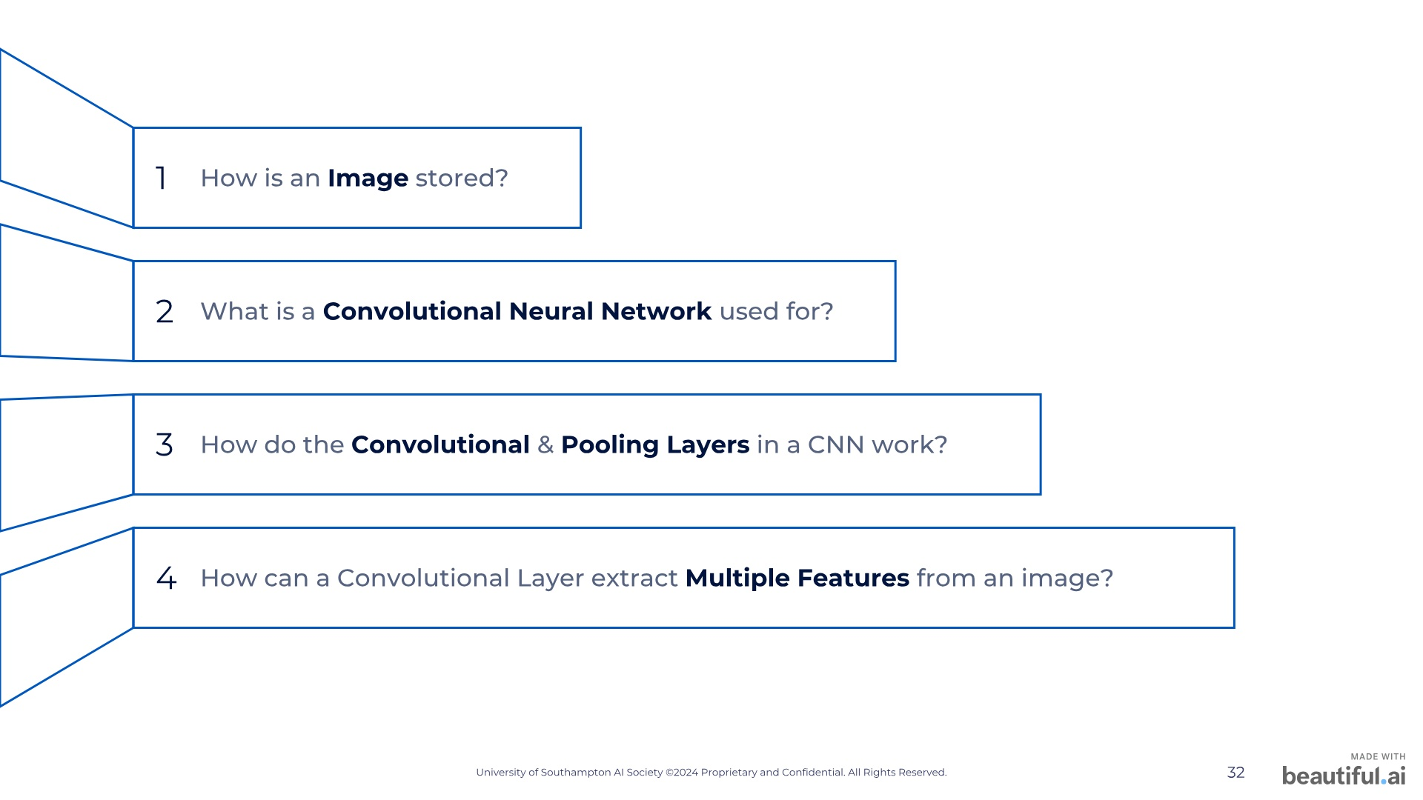
Notes:
Our society has three main objectives. Firstly we want to teach everybody about artificial intelligence, regardless of your academic background. This means that whether you are highly experienced or have no knowledge at all, you will be able to learn with us. Secondly, we want to provide opportunities for our members to gain practical experience with AI, so that you leave here not only knowing about AI but also being able to make AI. Lastly, we want our society to become a community for all members where we can have fun and create some memories. So how will we achieve these objectives? [next slide]

Slide 38
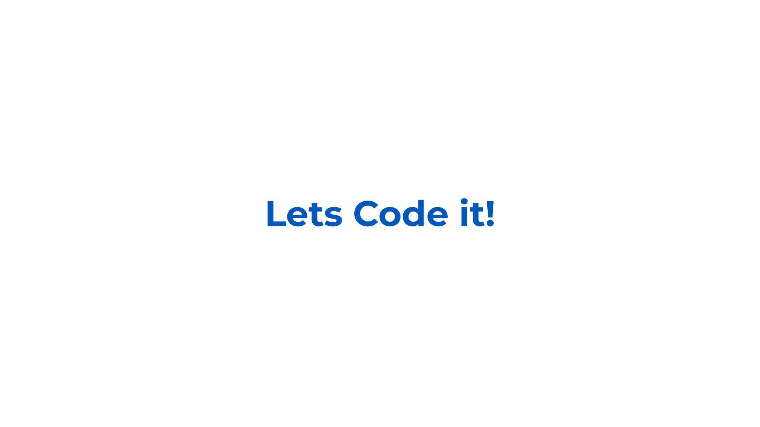

Slide 39
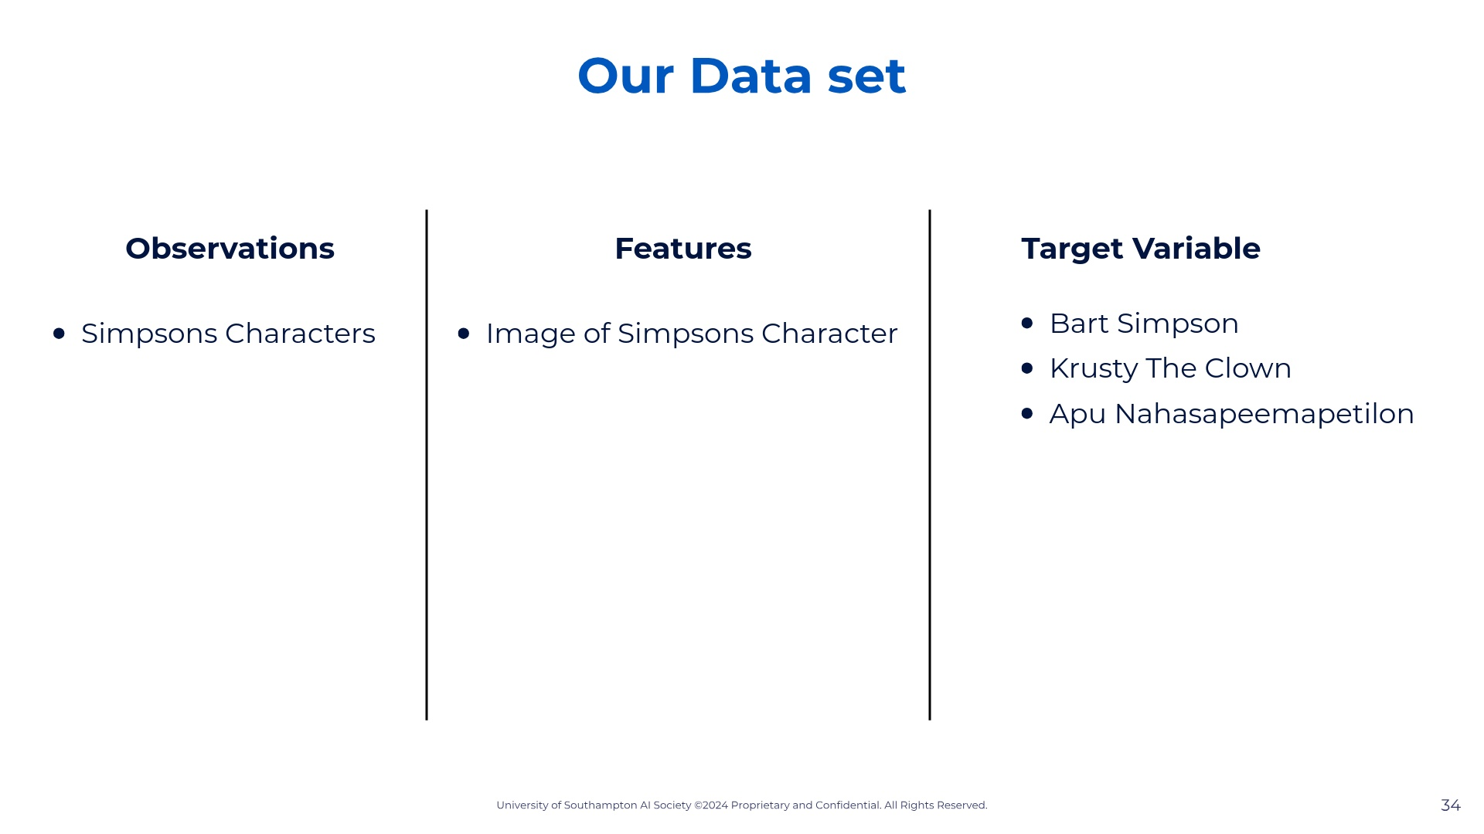
Notes:
Note that our data is all labelled. So for each observation we know how much was charged. In other words we know how much each patient paid. So we know this is a supervised learning problem.

Slide 40

Notes:
Note that our data is all labelled. So for each observation we know how much was charged. In other words we know how much each patient paid. So we know this is a supervised learning problem.

Slide 41
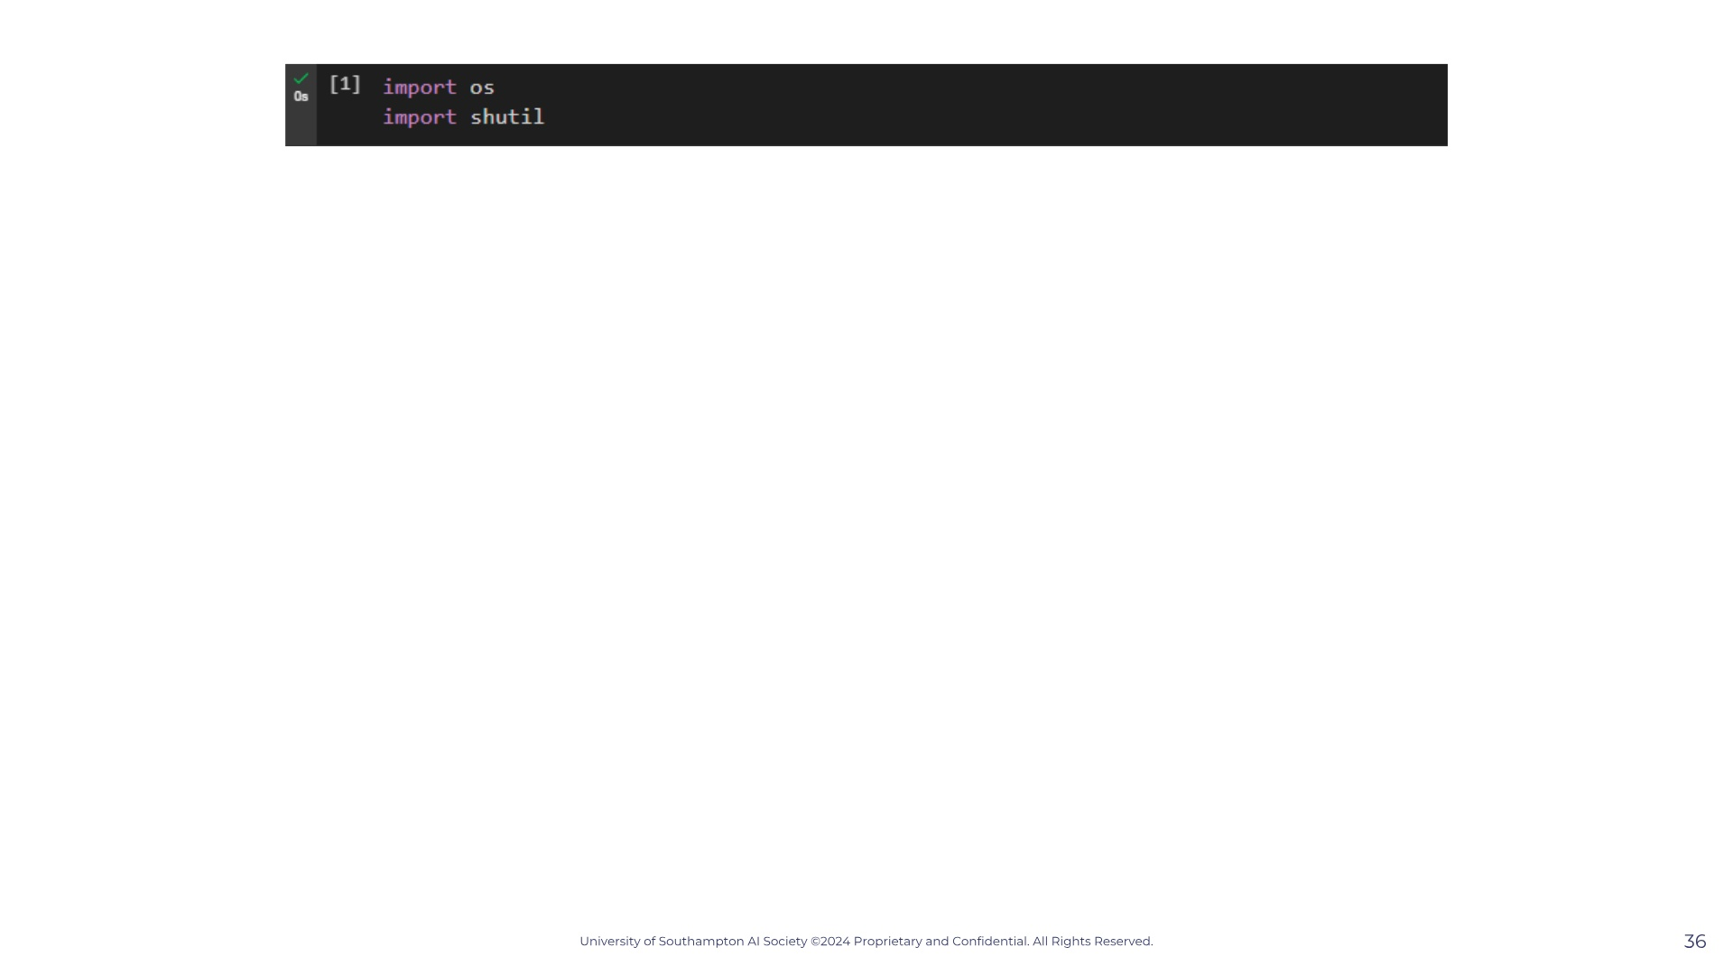
Notes:
Note that our data is all labelled. So for each observation we know how much was charged. In other words we know how much each patient paid. So we know this is a supervised learning problem.

Slide 42
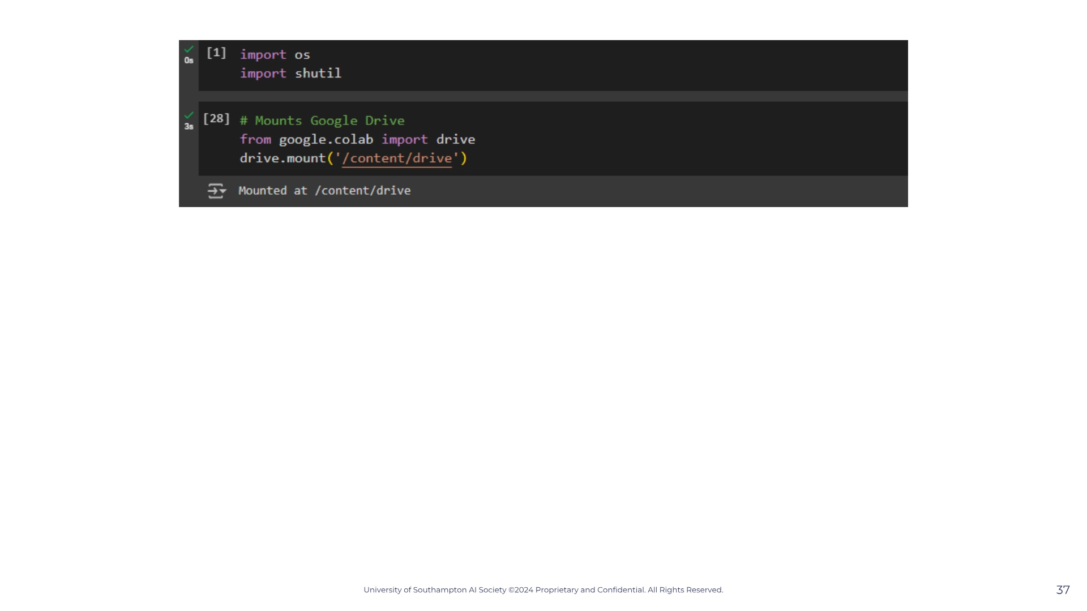
Notes:
Note that our data is all labelled. So for each observation we know how much was charged. In other words we know how much each patient paid. So we know this is a supervised learning problem.

Slide 43
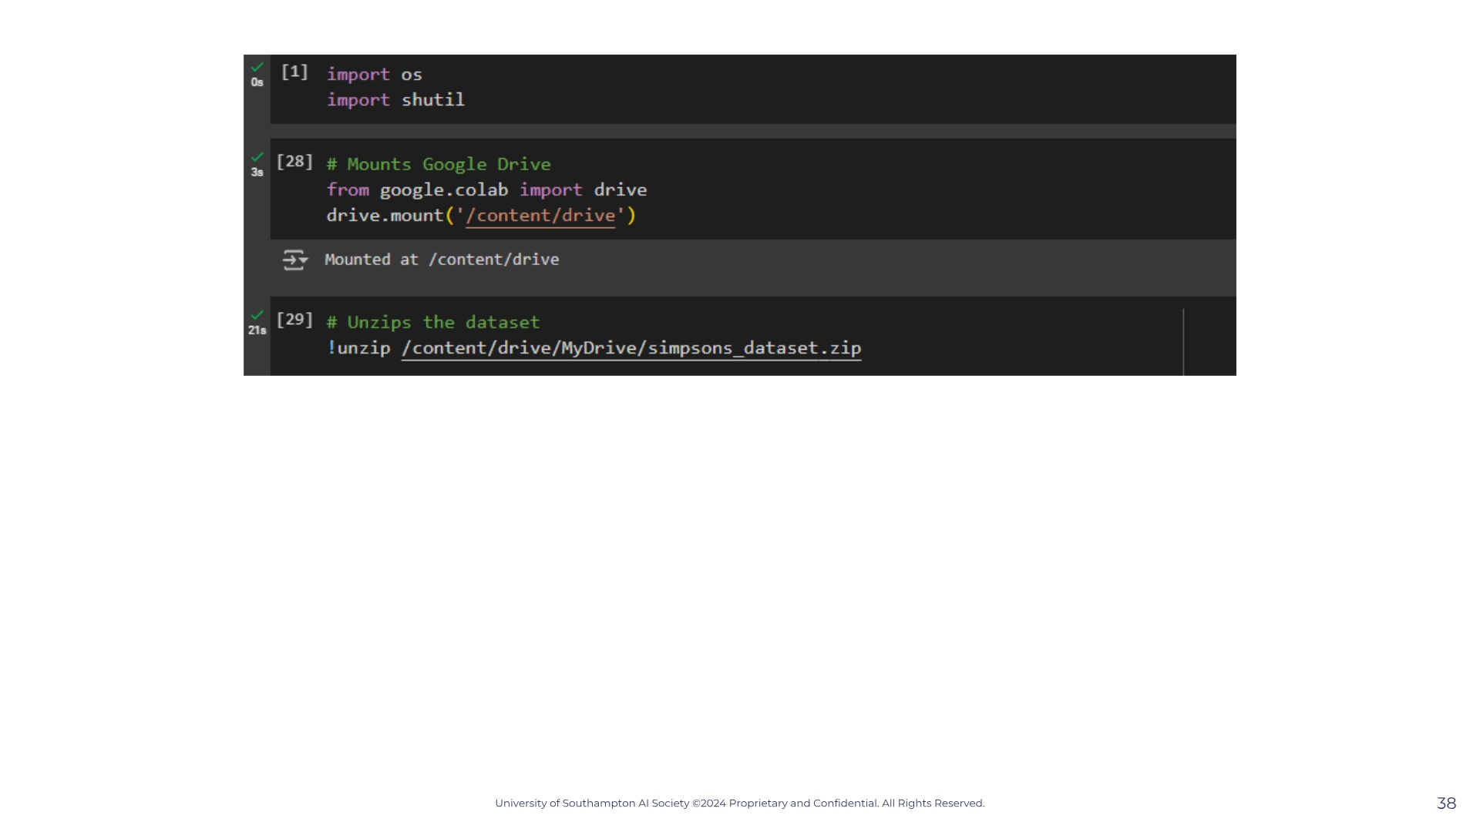
Notes:
Note that our data is all labelled. So for each observation we know how much was charged. In other words we know how much each patient paid. So we know this is a supervised learning problem.

Slide 44
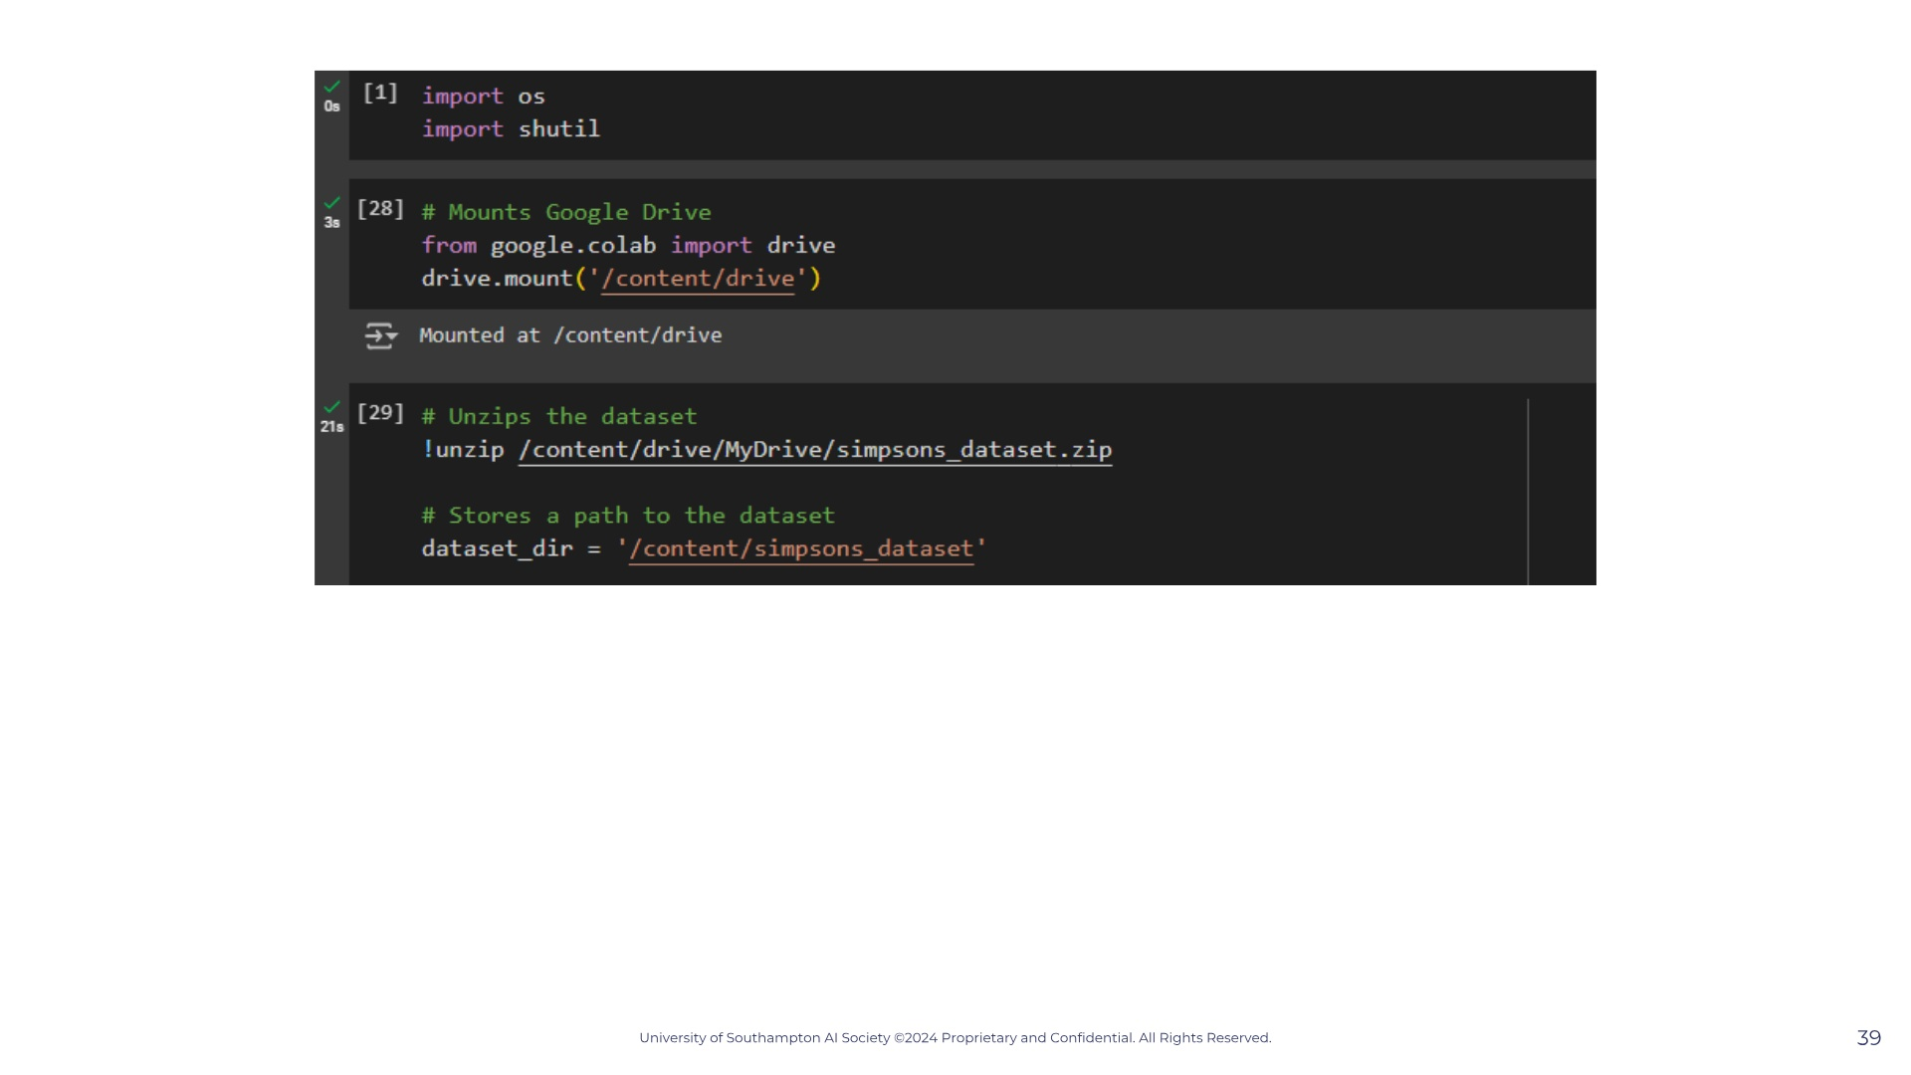
Notes:
Note that our data is all labelled. So for each observation we know how much was charged. In other words we know how much each patient paid. So we know this is a supervised learning problem.

Slide 45
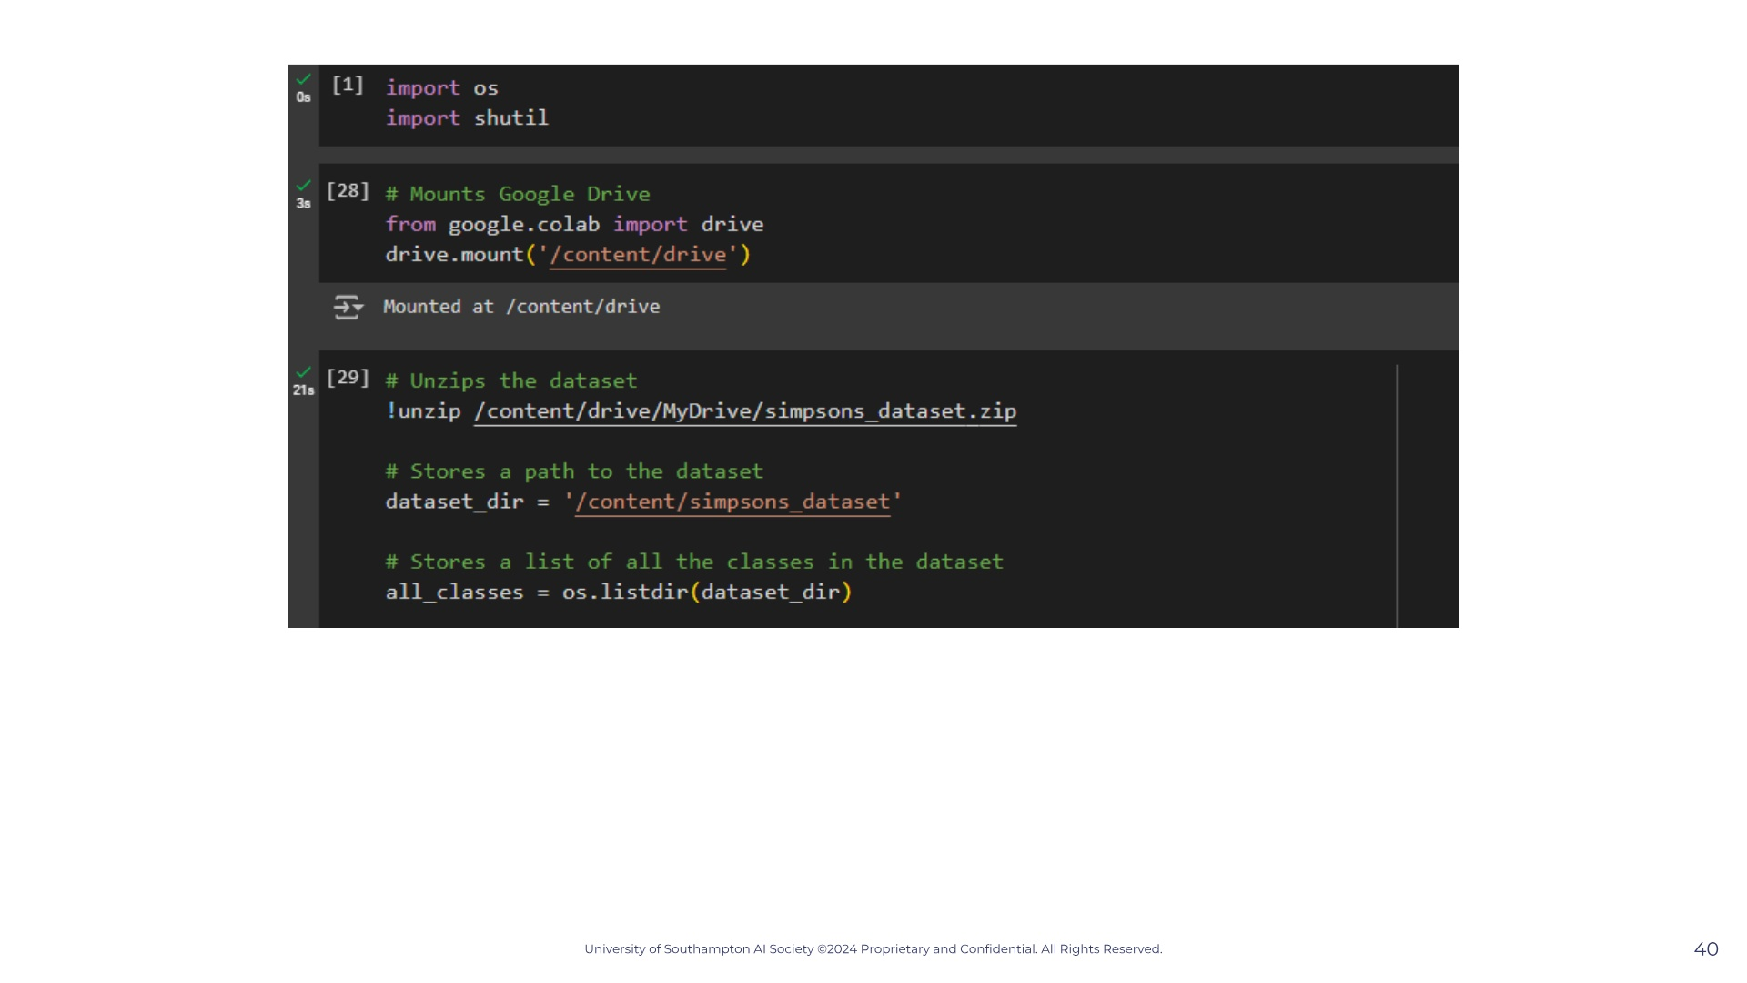
Notes:
Note that our data is all labelled. So for each observation we know how much was charged. In other words we know how much each patient paid. So we know this is a supervised learning problem.

Slide 46
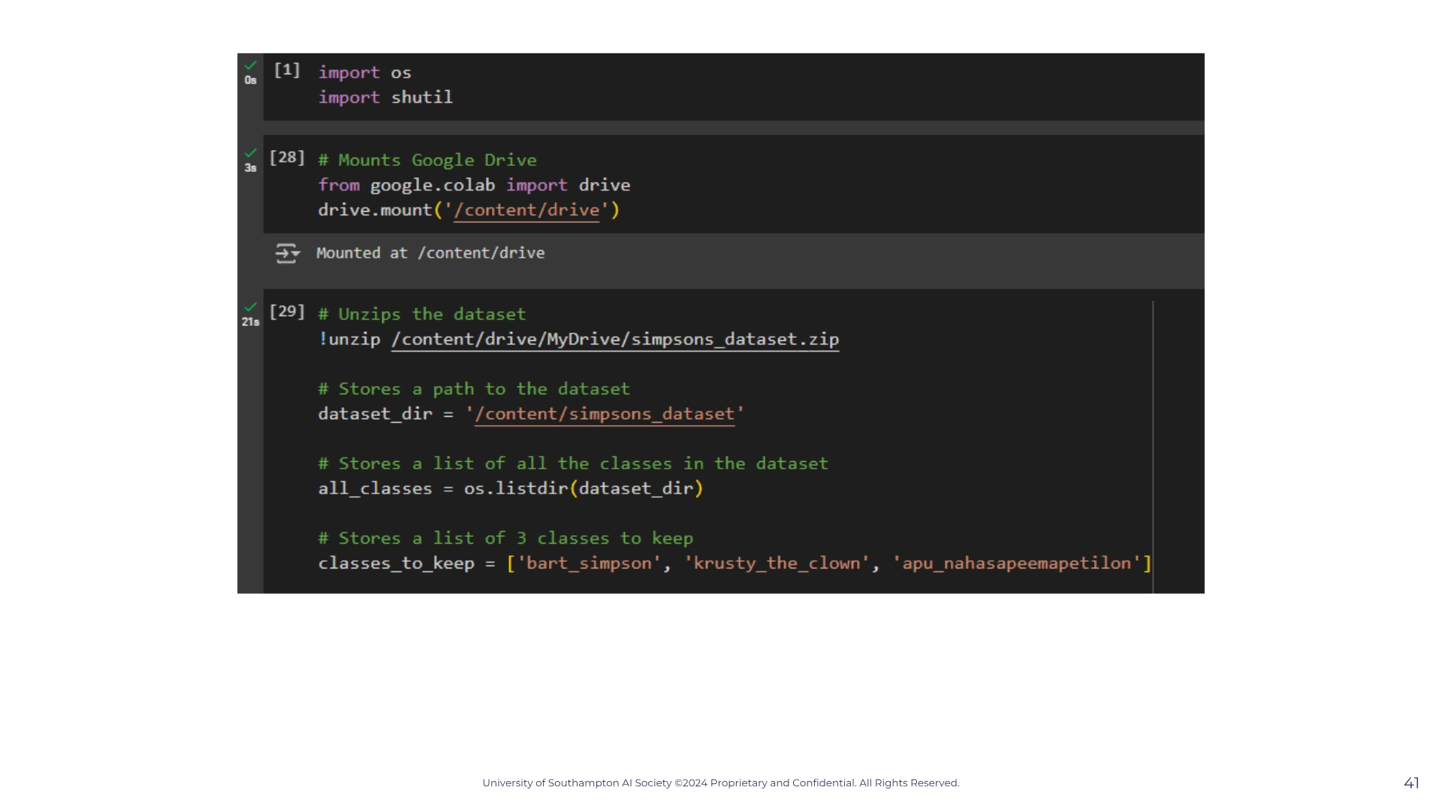
Notes:
Note that our data is all labelled. So for each observation we know how much was charged. In other words we know how much each patient paid. So we know this is a supervised learning problem.

Slide 47
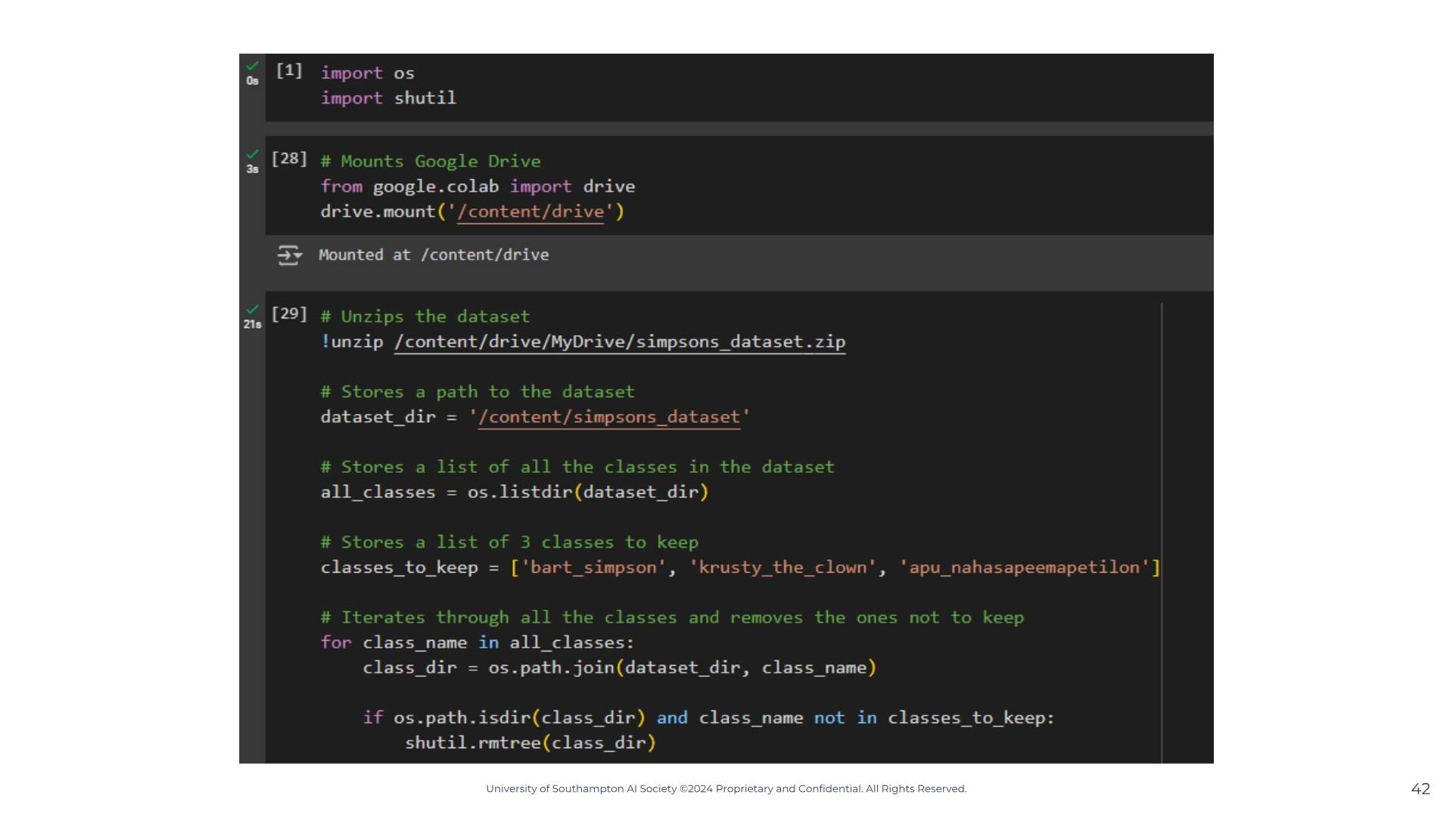
Notes:
Note that our data is all labelled. So for each observation we know how much was charged. In other words we know how much each patient paid. So we know this is a supervised learning problem.

Slide 48
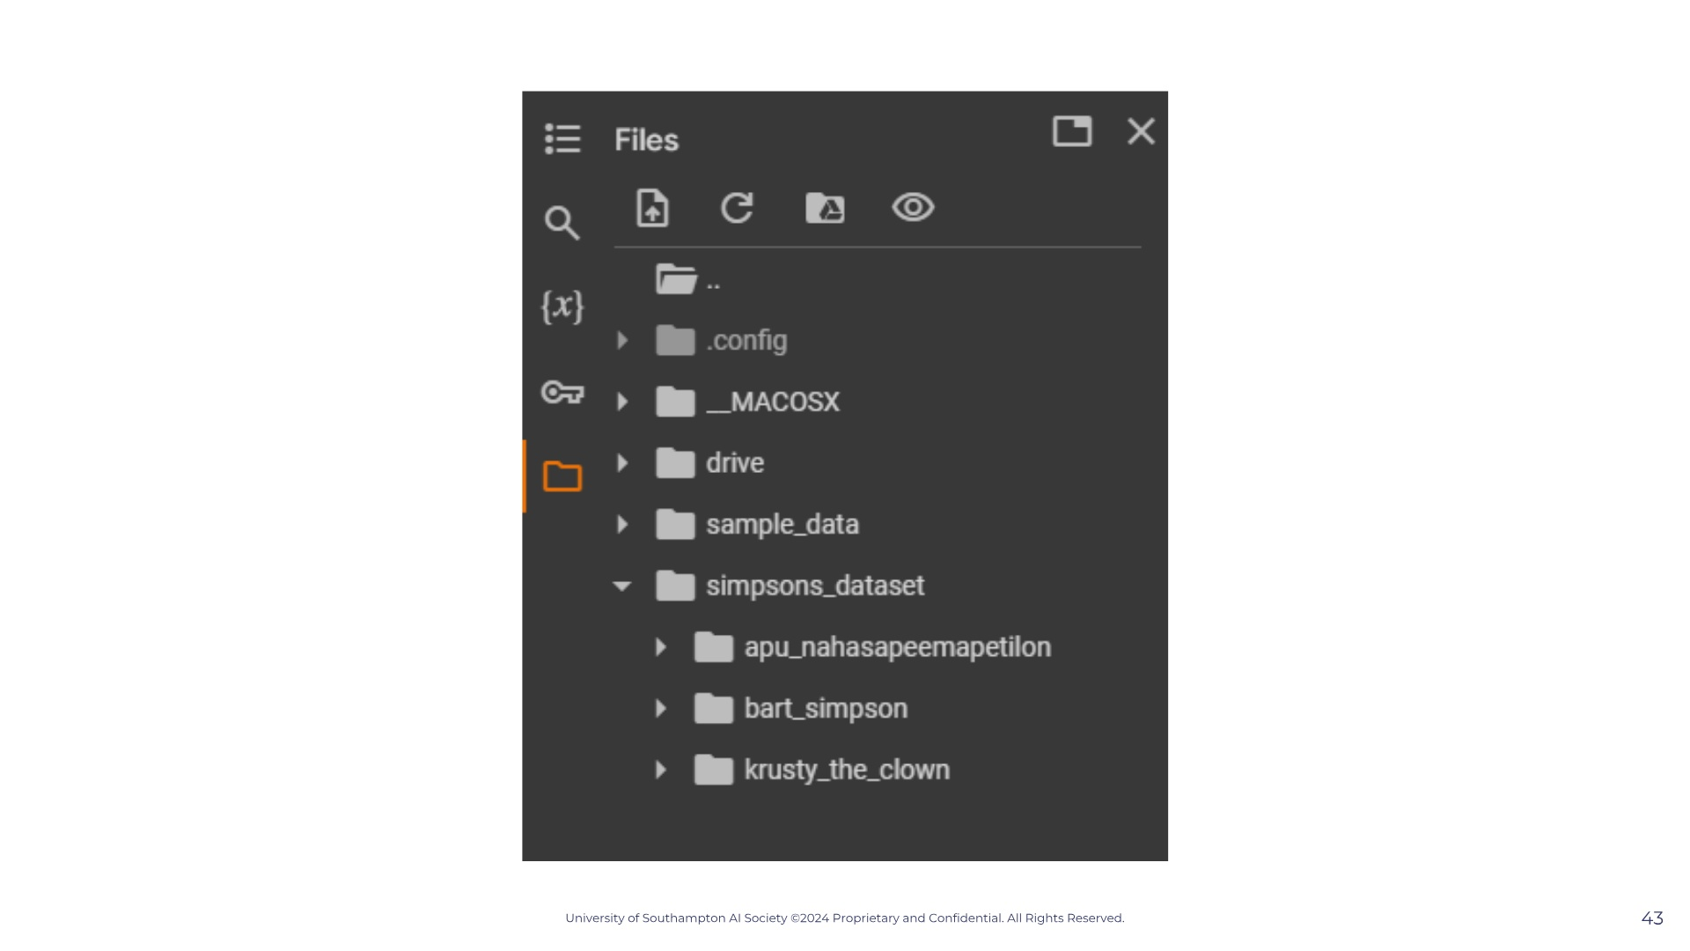
Notes:
Note that our data is all labelled. So for each observation we know how much was charged. In other words we know how much each patient paid. So we know this is a supervised learning problem.

Slide 49
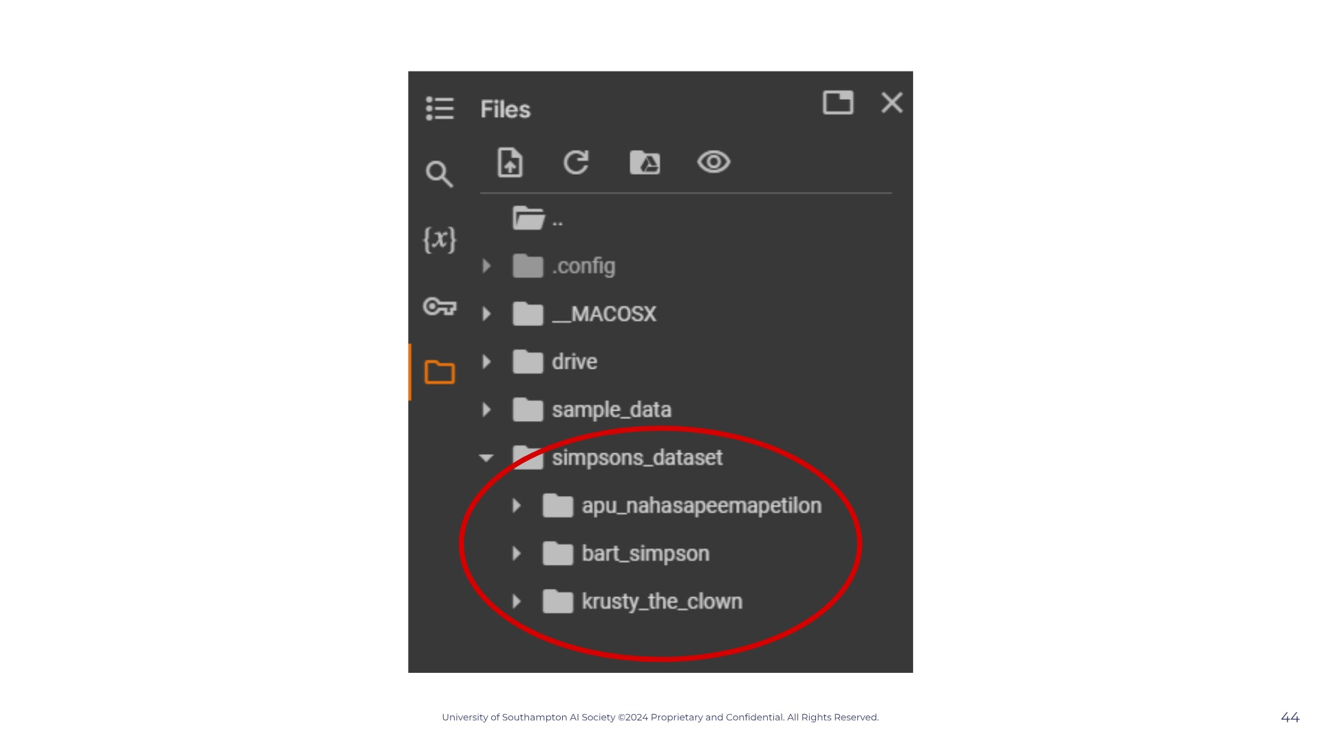
Notes:
Note that our data is all labelled. So for each observation we know how much was charged. In other words we know how much each patient paid. So we know this is a supervised learning problem.

Slide 50

Notes:
Note that our data is all labelled. So for each observation we know how much was charged. In other words we know how much each patient paid. So we know this is a supervised learning problem.

Slide 51
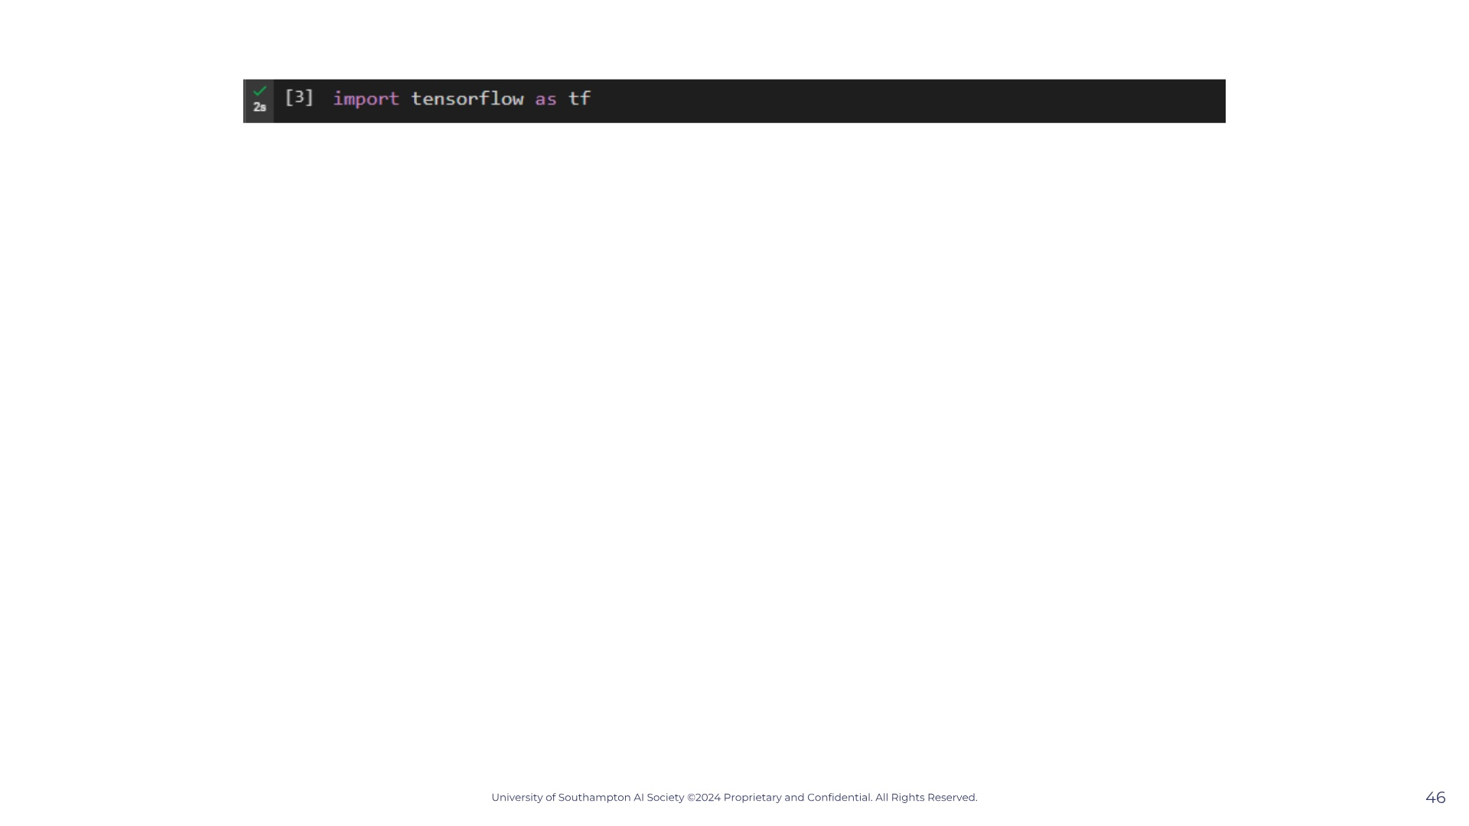
Notes:
Note that our data is all labelled. So for each observation we know how much was charged. In other words we know how much each patient paid. So we know this is a supervised learning problem.

Slide 52
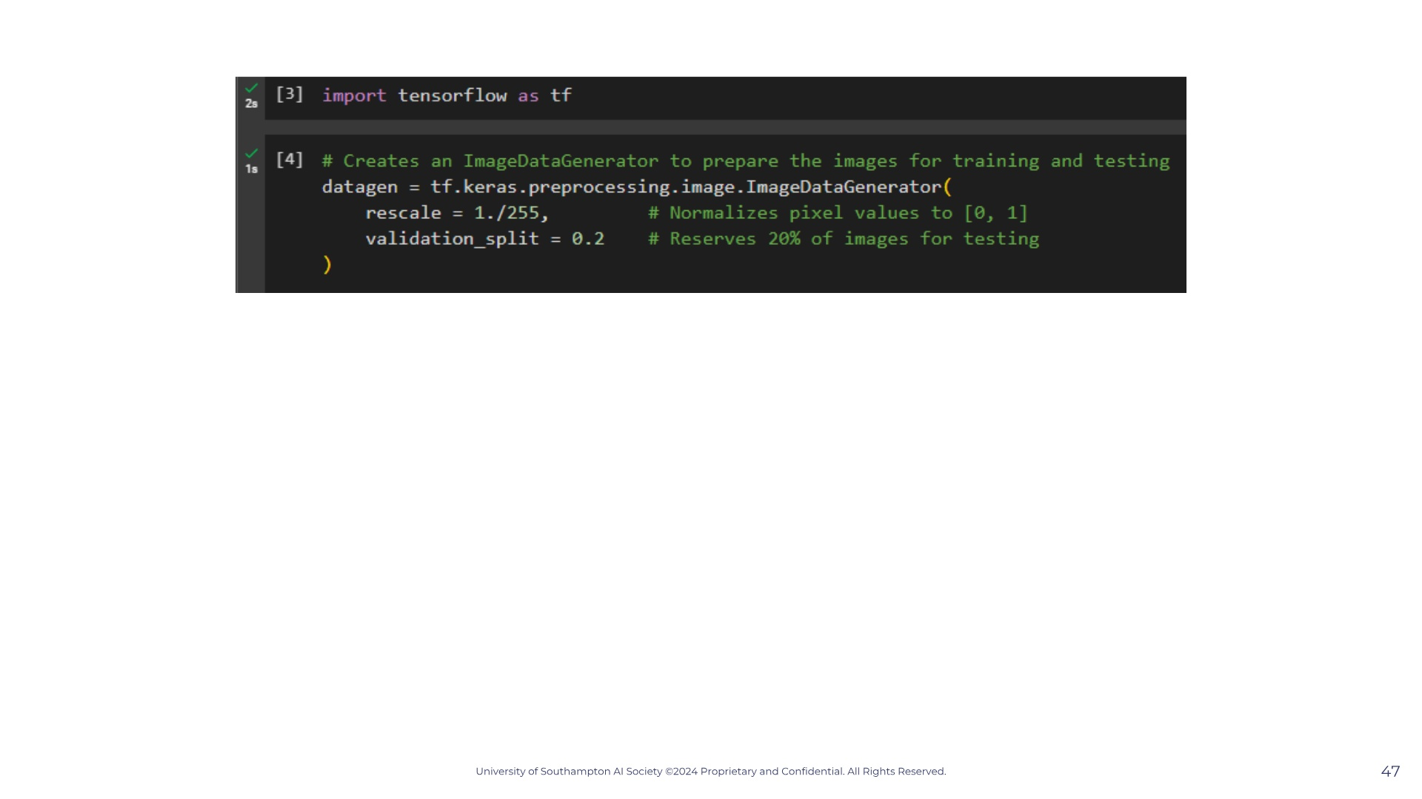
Notes:
Note that our data is all labelled. So for each observation we know how much was charged. In other words we know how much each patient paid. So we know this is a supervised learning problem.

Slide 53
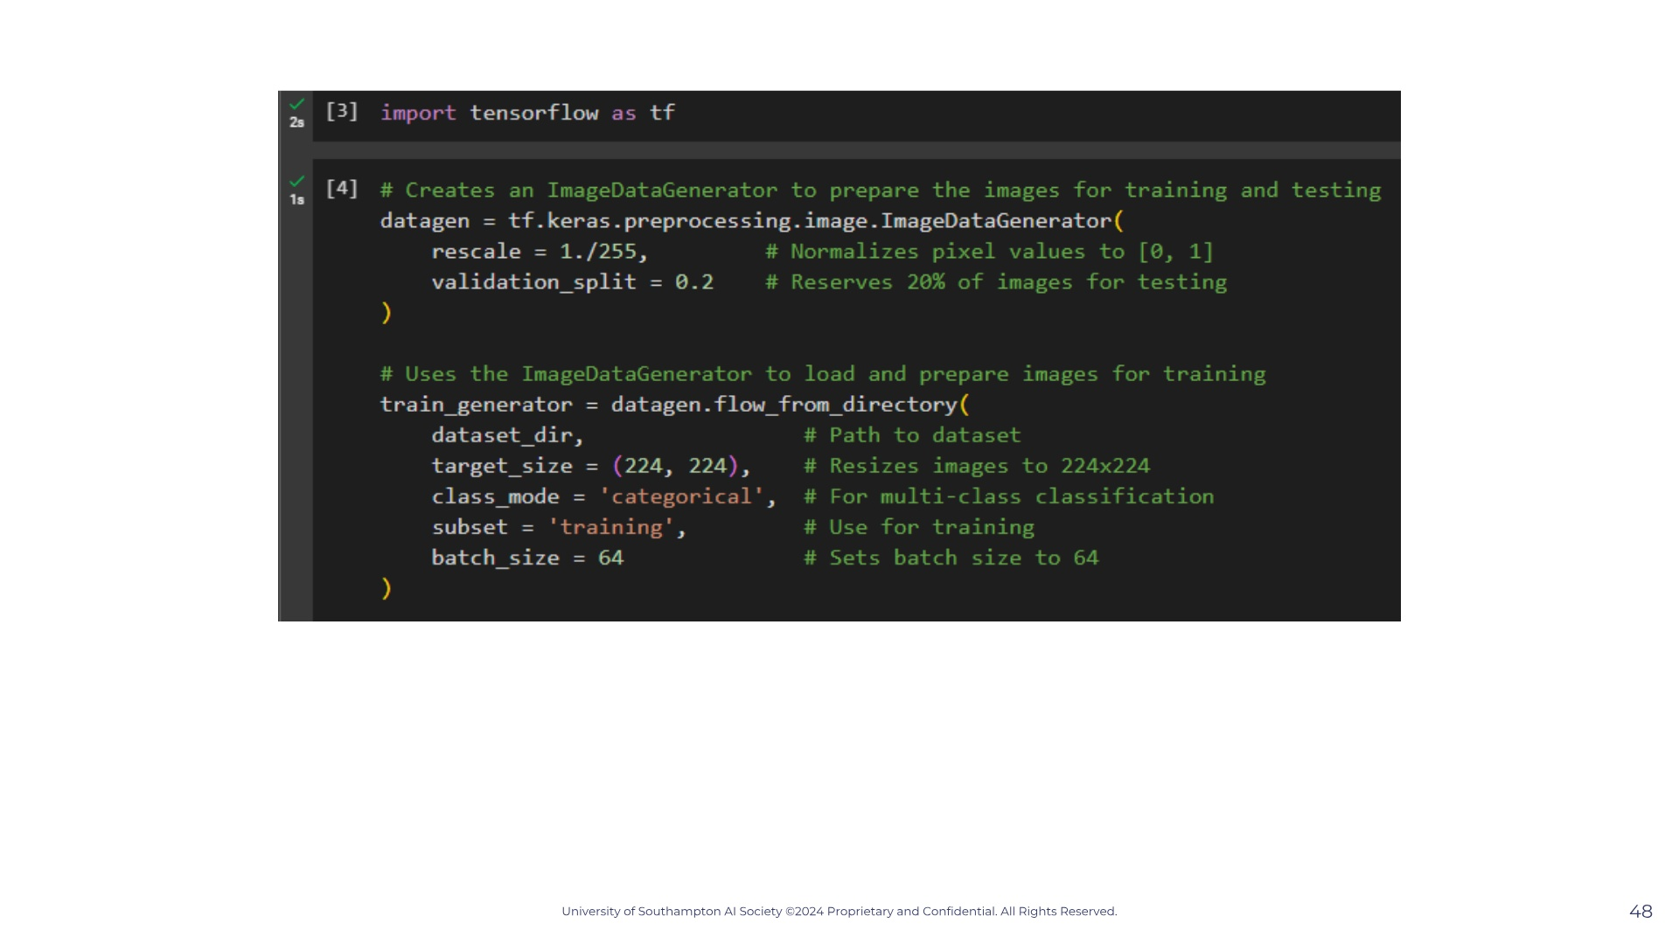
Notes:
Note that our data is all labelled. So for each observation we know how much was charged. In other words we know how much each patient paid. So we know this is a supervised learning problem.

Slide 54
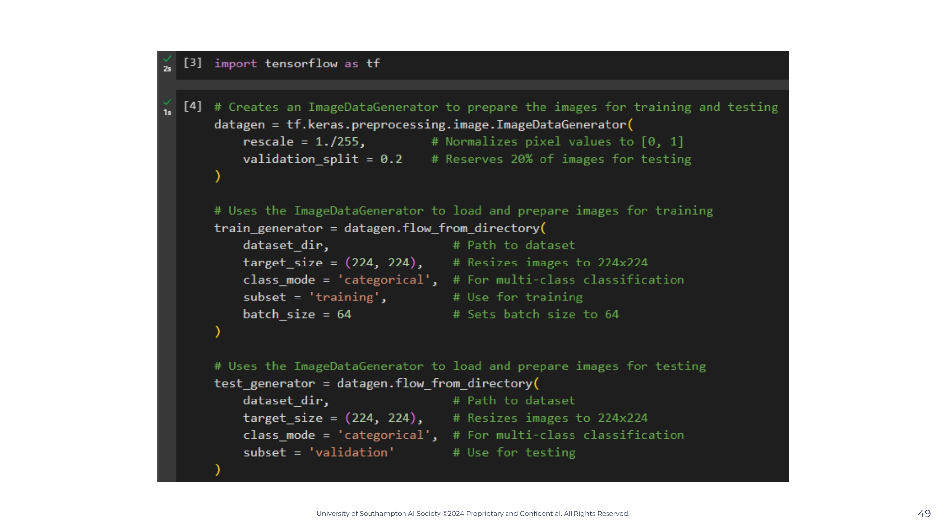
Notes:
Note that our data is all labelled. So for each observation we know how much was charged. In other words we know how much each patient paid. So we know this is a supervised learning problem.

Slide 55
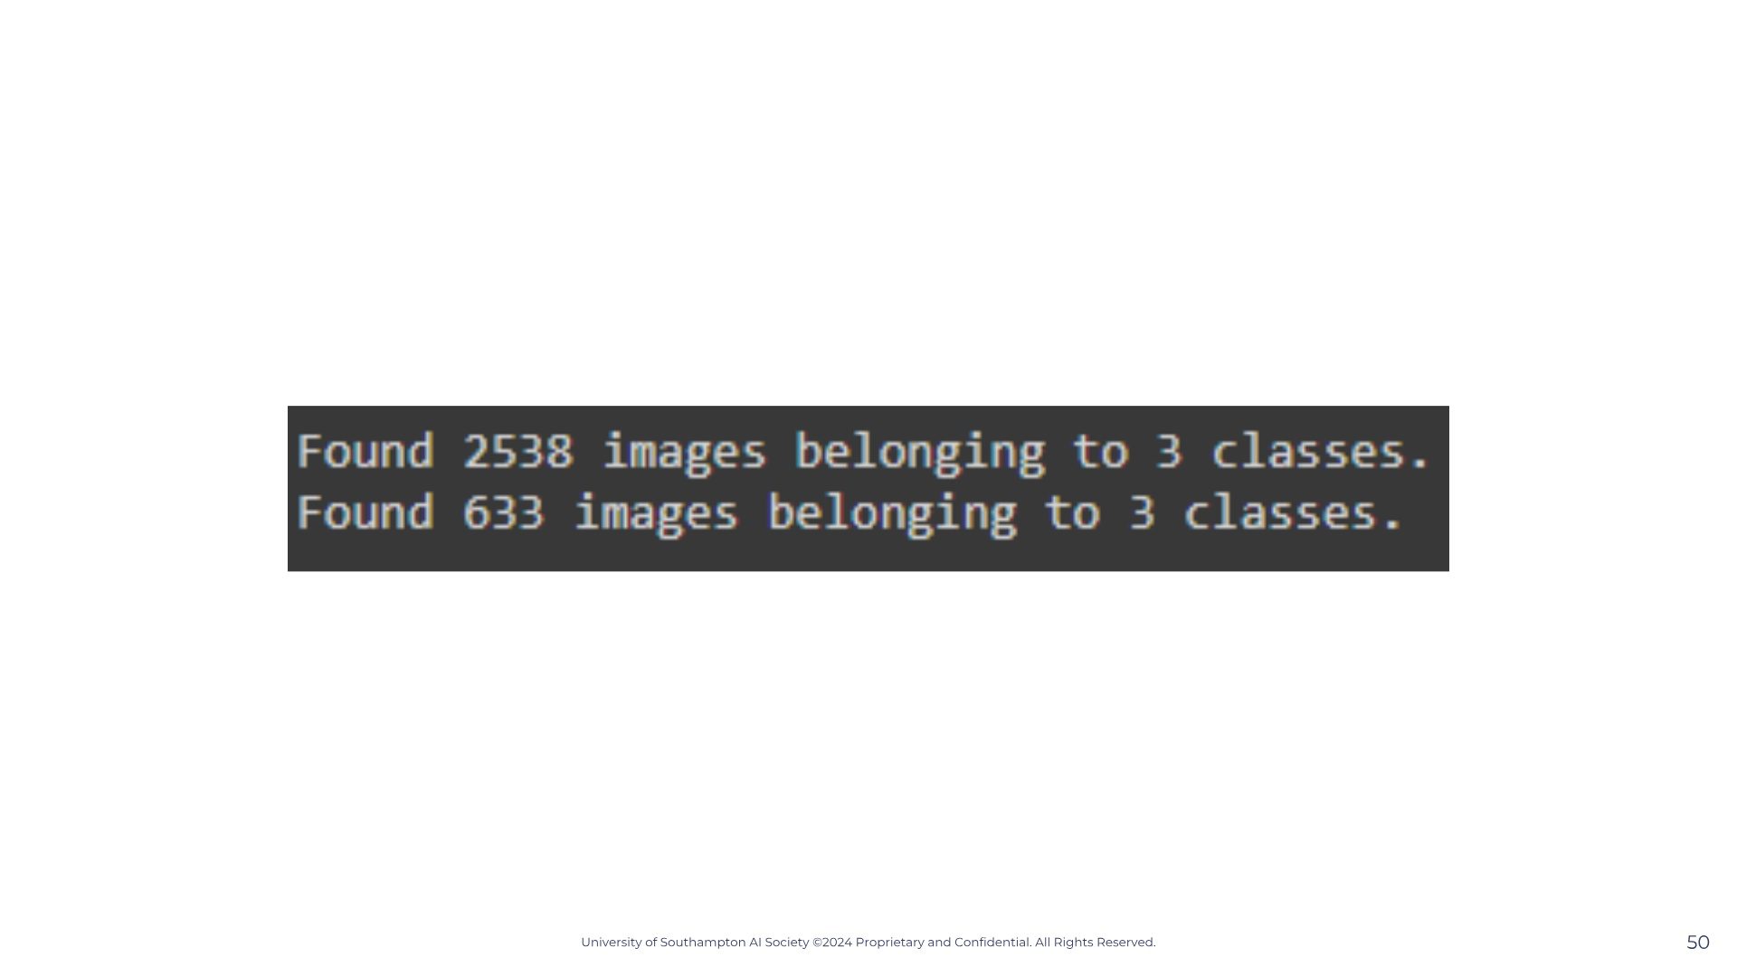
Notes:
Note that our data is all labelled. So for each observation we know how much was charged. In other words we know how much each patient paid. So we know this is a supervised learning problem.

Slide 56

Notes:
Note that our data is all labelled. So for each observation we know how much was charged. In other words we know how much each patient paid. So we know this is a supervised learning problem.

Slide 57
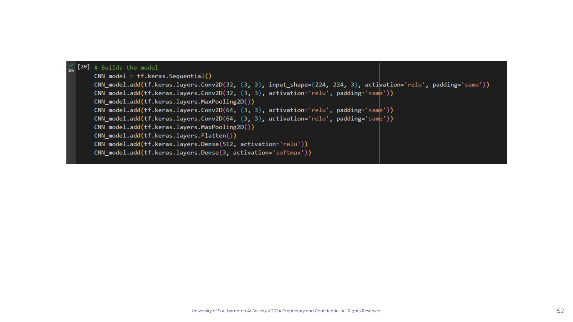
Notes:
Note that our data is all labelled. So for each observation we know how much was charged. In other words we know how much each patient paid. So we know this is a supervised learning problem.

Slide 58
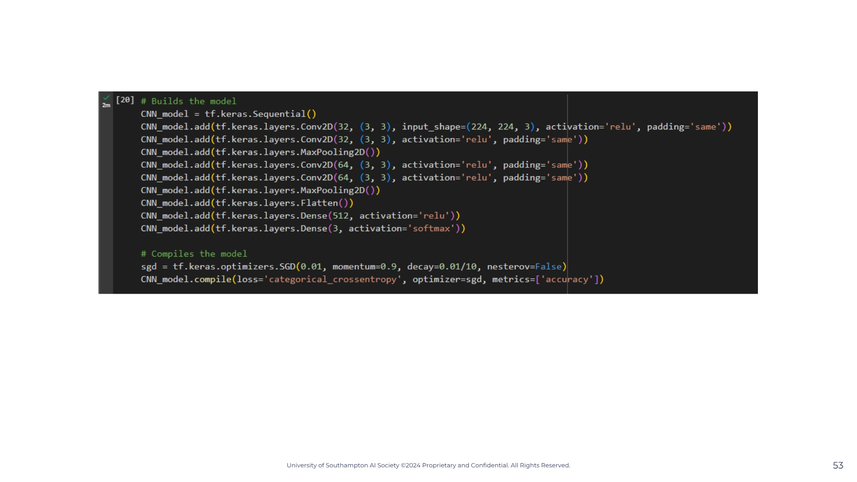
Notes:
Note that our data is all labelled. So for each observation we know how much was charged. In other words we know how much each patient paid. So we know this is a supervised learning problem.

Slide 59
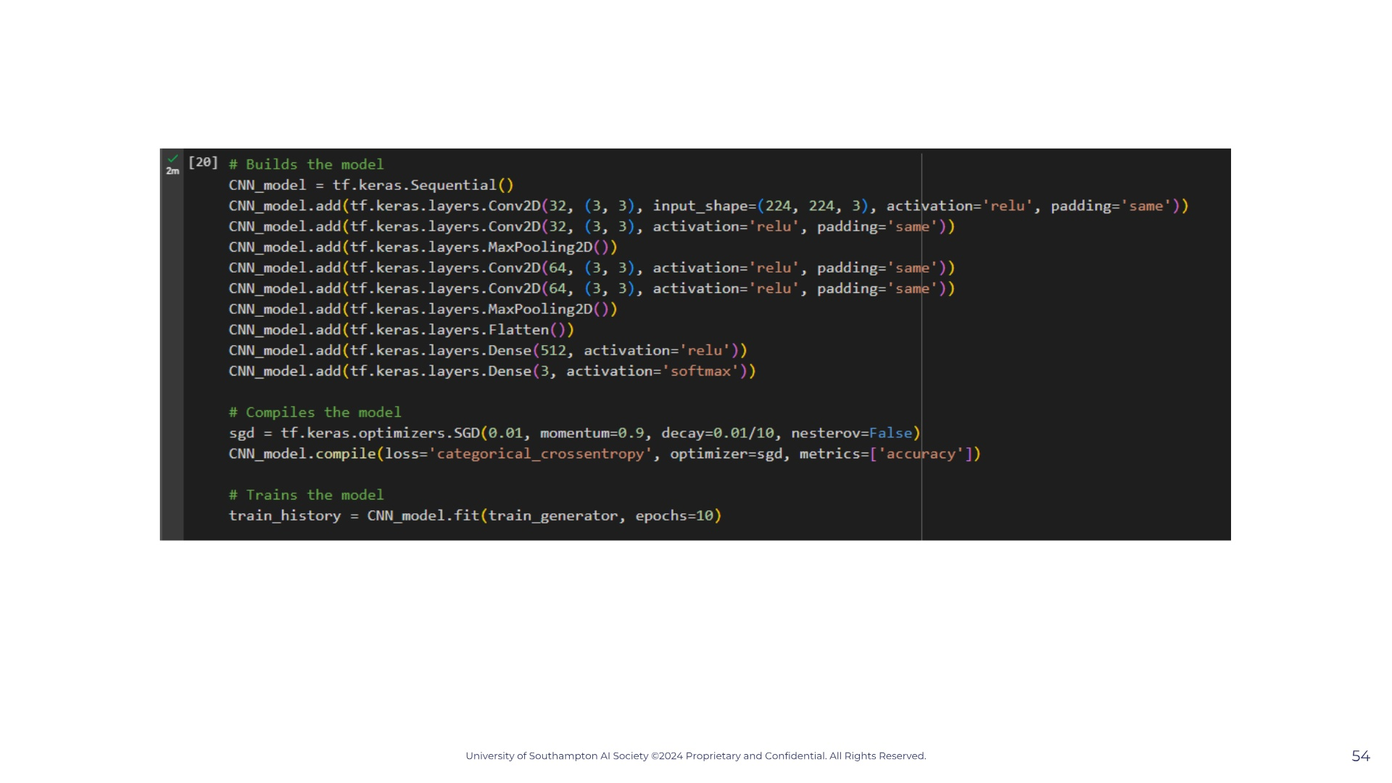
Notes:
Note that our data is all labelled. So for each observation we know how much was charged. In other words we know how much each patient paid. So we know this is a supervised learning problem.

Slide 60
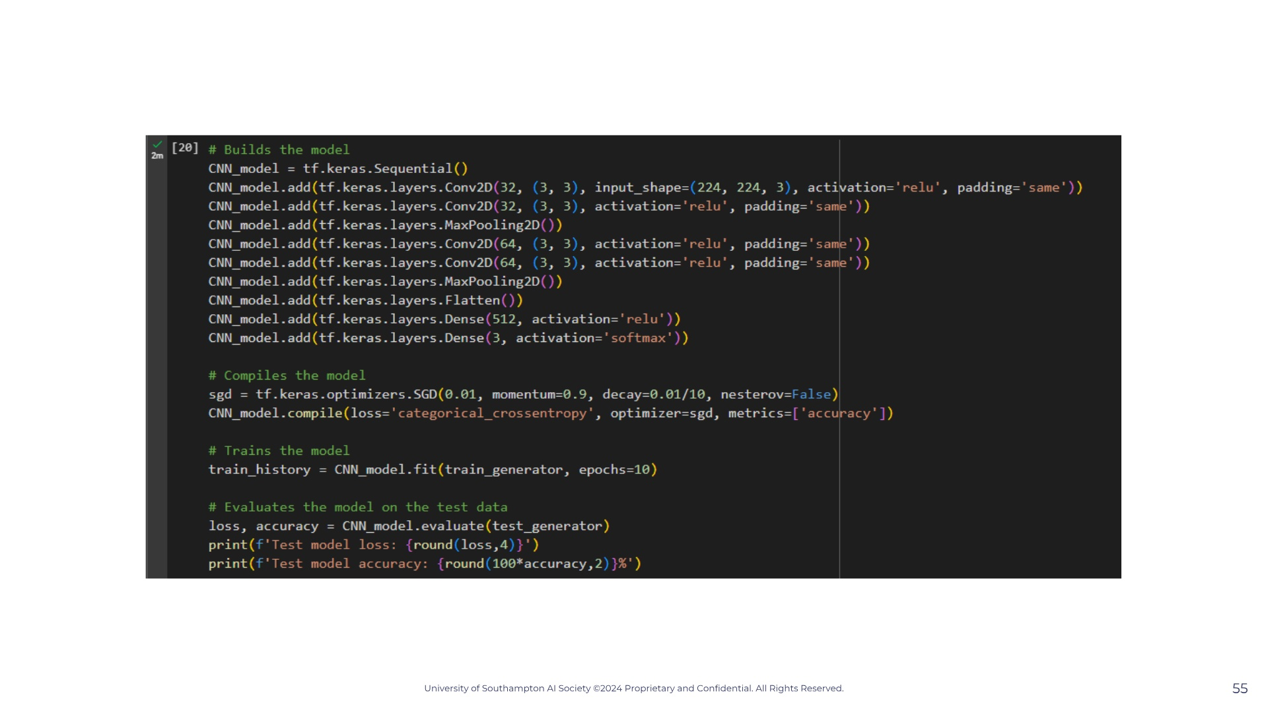
Notes:
Note that our data is all labelled. So for each observation we know how much was charged. In other words we know how much each patient paid. So we know this is a supervised learning problem.

Slide 61

Notes:
— so as we were saying, what actually happens in each node after our input layer? Lets answer this by seeing what happens in one node only. — Well on our screen we have a very simple neural network with three inputs and one node that then give the neural networks output. What is actually happening in this node is that our x-inputs are being multiplied by a parameter called "weight". This weight value is any real number at all, that the computer chooses randomly, that varies between each x-input, and is multiplied with it's respective x-input. So we can weight1 x x1 + w2x2 + w3x3. The reason this is done is because it obviously increases the amount that each variable influences our our equation, because if we have a a w1 of 100 and a w2 of 1 then the x1 is going to be much bigger than x2. — As we have three x values and three w values, we can vectorise this and so have a matrix multiplication just to simplify the notation. If you don't know matrices that's fine just remember that this small z equation you see if the same as the one on top. — After that is done there is another value that is added with is the bias value. This constant is also randomly assigned and usually starts off with a value of 0 or 1. This is value you can think of as the constant b we have in linear equations. It's used to create a horizontal shift, which won't make much sense now but it will in a bit. — So now we have an equation z for this specific node, but we are still not done. Then the node runs this equation through what we call an activation function, which you can see on screen with the g(z). What is g(z)? Activation function. Our activation function is any function at all but the typically used ones are the sigmoid function and the ReLu function. Lets quickly go over them.

Slide 62

Notes:
Note that our data is all labelled. So for each observation we know how much was charged. In other words we know how much each patient paid. So we know this is a supervised learning problem.

Slide 63

Notes:
Note that our data is all labelled. So for each observation we know how much was charged. In other words we know how much each patient paid. So we know this is a supervised learning problem.

Slide 64

Notes:
Note that our data is all labelled. So for each observation we know how much was charged. In other words we know how much each patient paid. So we know this is a supervised learning problem.

Slide 65

Notes:
Note that our data is all labelled. So for each observation we know how much was charged. In other words we know how much each patient paid. So we know this is a supervised learning problem.

Slide 66

Notes:
Note that our data is all labelled. So for each observation we know how much was charged. In other words we know how much each patient paid. So we know this is a supervised learning problem.

Slide 67

Notes:
Note that our data is all labelled. So for each observation we know how much was charged. In other words we know how much each patient paid. So we know this is a supervised learning problem.

Slide 68

Notes:
Note that our data is all labelled. So for each observation we know how much was charged. In other words we know how much each patient paid. So we know this is a supervised learning problem.

Slide 69

Notes:
Note that our data is all labelled. So for each observation we know how much was charged. In other words we know how much each patient paid. So we know this is a supervised learning problem.

Slide 70

Notes:
Note that our data is all labelled. So for each observation we know how much was charged. In other words we know how much each patient paid. So we know this is a supervised learning problem.

Slide 71

Notes:
Note that our data is all labelled. So for each observation we know how much was charged. In other words we know how much each patient paid. So we know this is a supervised learning problem.

Slide 72

Notes:
Note that our data is all labelled. So for each observation we know how much was charged. In other words we know how much each patient paid. So we know this is a supervised learning problem.

Slide 73

Notes:
Note that our data is all labelled. So for each observation we know how much was charged. In other words we know how much each patient paid. So we know this is a supervised learning problem.

Slide 74

Notes:
Note that our data is all labelled. So for each observation we know how much was charged. In other words we know how much each patient paid. So we know this is a supervised learning problem.

Slide 75

Notes:
Note that our data is all labelled. So for each observation we know how much was charged. In other words we know how much each patient paid. So we know this is a supervised learning problem.

Slide 76

Notes:
Note that our data is all labelled. So for each observation we know how much was charged. In other words we know how much each patient paid. So we know this is a supervised learning problem.

Slide 77

Notes:
Note that our data is all labelled. So for each observation we know how much was charged. In other words we know how much each patient paid. So we know this is a supervised learning problem.

Slide 78

Notes:
Note that our data is all labelled. So for each observation we know how much was charged. In other words we know how much each patient paid. So we know this is a supervised learning problem.

Slide 79

Notes:
Note that our data is all labelled. So for each observation we know how much was charged. In other words we know how much each patient paid. So we know this is a supervised learning problem.

Slide 80


